Slide 1
Greg Jones
Airspace and Land Use Manager
(850) 414-4502
Aviation and Spaceports Office
Florida Department of Transportation
605 Suwannee Street, MS 46
Tallahassee, FL 32399-0450 www.fdot.gov/aviation (new)
Florida Chapter 333, Airport Zoning

Slide 2
Understanding the need and responsibility for Airport Zoning Regulations
F.S. 333.03(2016) Requirement to adopt airport zoning regulations
  (1)(a) Every political subdivision having an airport hazard area within it territorial limits SHALL adopt, administer, and enforce, under the police power and in the manner and upon the conditions prescribed in this section airport protection zoning regulations for such airport hazard area.

Slide 3
333.01(4)
“Airport hazard area” means any area of land or water upon which an airport hazard might be established if not prevented as provided in this chapter.
“Airport hazard area” means any area of land or water upon which an airport hazard might be established.

Slide 4
333.01(3)
“Airport hazard” means an obstruction to air navigation which affects the safe and efficient use of navigable airspace or the operation of planned or existing air navigation and communication facilities any structure or tree or use of land which would exceed the federal obstruction standards as contained in 14 C.F.R. ss. 77.21, 77.23, 77.25, 77.28, and 77.29 and which obstructs the airspace required for the flight of aircraft in taking off, maneuvering, or landing or is otherwise hazardous to such taking off, maneuvering, or landing of aircraft and for which no person has previously obtained a permit or variance pursuant to s. 333.025 or s. 333.07.
“Airport hazard” means an obstruction to air navigation which affects the safe and efficient use of navigable airspace or the operation of planned or existing air navigation and communication facilities.

Slide 5
333.01(12)(7)
"Obstruction" means any existing or proposed manmade object or object, of natural growth or terrain, or structure construction or alteration that exceeds violates the federal obstruction standards contained in 14 C.F.R. part 77, subpart C ss. 77.21, 77.23, 77.25, 77.28, and 77.29. The term includes:
"Obstruction" means any existing or proposed object, terrain, or structure construction or alteration that exceeds the federal obstruction standards contained in 14 C.F.R. part 77, subpart C. The term includes:

Slide 6
Introduction and Comments by Presenter
Greg Jones

Slide 7
Disclaimer
Presentation is not legal advice - not our function
DOT does not approve regulations
Responsibility of zoning authority to insure compliance with statutory zoning requirements
Determination of whether your regulations are adequate and whether you are in compliance with zoning statute is a legal issue
  FS 333 is statutory law and therefore requires compliance/ provides penalties for failure to comply
Failure to comply with statute can also result in adverse impact to permitting process - appeals and legal action by opposing parties
DOT provides assistance with federal obstruction standards Part 77 - will assist with zoning but those are usually legal issues

Slide 8
History
The most recent amendments to Chapter 333, Florida Statutes (FS 333) occurred in the early 1990’s and 2002.
In mid-2014 FS 333 was being revised for submittal to the legislature in 2015.
Prior to that a Working group of airports, the Aviation Office and local governments worked on the proposed revisions which were intended to give local jurisdictions more power and reduce some of the obligations to the FDOT.
In late 2014 the Aviation Office and FDOT General Counsel’s Office became involved with the final drafting of the proposed revisions to FS 333.
The proposed revisions were submitted to the 2015 legislature but because of their early adjournment the bills were not addressed.
In 2016 the various bills were submitted to the legislature regarding amendment of FS 333 and HB 7061 and SB 1508 were passed.
SB 1508 was a stand alone bill for revision of only FS 333; HB 7061 had several FDOT related statutes that were submitted for revision including FS 333.
In HB 7061 the section related to FS 333 is found at Section 21, page 58/140 and continues to page 91/140.
Both bills were passed but I was informed that since HB 7061 was passed last it is the controlling legislation- there are some differences between 7061 and 1508.
A comparison between the FS 333 found in HB 7061 and the present/2016 version found on the legislative website are verbatim so we have proceeded using HB 7061 as the source of the new FS 333 in comparing text changes between the bill and the statute.

Slide 9
Significant Changes
Definitions
Shows new numbering of Part 77, subpart C
New criteria for FDOT evaluation of permit applications
New criteria and processes for political subdivision’s airport zoning regulations
Modifications to land use compatibility regulations
Requirement for political subdivisions having land underlying Part 77 surfaces to have Interlocal Agreement or Joint Zoning Board for Airport Zoning
Transition provisions
Submittal requirements to the FDOT Aviation Office
Repeal of certain sections

Slide 10
Airport Hazards and uses of land in airport vicinities contrary to public interest
F.S. 333.02
  “An airport hazard endangers the live and property of users of the airport and occupants of land in its vicinity”
  “Certain uses of land are not compatible with normal airport operations”
  “Airport hazard and incompatible use of land are public nuisances”
  “In the interest of public health, public safety and general welfare to prevent airport hazards and incompatible land uses”

Slide 11
Why the Presentation and Resource Documents
With the new statute – there was concern with identifying the changes and how they would effect modifications to existing regulations.
The resource documents including this presentation provide information about the changes that need to be made to your existing regulations and processes.
These changes are mandated by state law – NOT the FDOT.
As we will describe later, there are penalties and consequences for failing to comply with this statute.
We wanted to provide resource documents that we can share in discussing these changes to train and inform others.

Slide 12
Suggested Action Plan Overview
Identify and establish the entity that will function as the administrative agency/permitting board to administer and enforce airport zoning regulations; identify your process for promulgating airport zoning regulations
Determine if an Interlocal Agreement or Joint Zoning Board is required in accordance with F.S. 333.03(1)(b) and identify and coordinate with the political subdivisions that are affected
Political subdivision(s) adopt airport zoning regulations by July 1, 2017
Political subdivisions provide adopted airport zoning regulations and amendments to FDOT within 30 days after adoption, in accordance with F.S. 333.03(3).
Upon receipt of a complete permit application, the local government shall provide a copy of the application to the Aviation and Spaceports Office for a 15 day review period, in accordance with F.S. 333.025(4).

Slide 13
Zoning Authorities' Submittal Responsibilities to
FDOT Aviation and Spaceports Office (Aviation Office) in accordance with F.S. 333(2016)

Slide 14
Submittal to FDOT Aviation Office
Submittal to Aviation Office of adopted Airport Zoning Regulations and amendments in accordance with F.S. 333.03(3)(2016) “… provide a copy … to department’s aviation office …. .”within 30 days after adoption.” This would also comply with the requirement to “place on file” zoning regulation with FDOT (FS 333.025(4))
Adopted/amended regulations and related questions should be emailed to:
DOTRegulationReview@dot.state.fl.us

Slide 15
S. 333.03(3), F.S.
Political subdivisions shall provide a copy of all airport protection zoning regulations and airport land use compatibility zoning regulations, and any related amendments, to the department's aviation office within 30 days after adoption.

Slide 16
Submittal to FDOT Aviation Office
Submittal to Aviation Office of Airport Zoning of airport zoning permit applications upon receipt by political subdivisions in accordance with F.S. 333.025(4)(2016)[“upon receipt of complete application local government shall provide copy to aviation office by delivery receipt”]
Zoning permit applications from political subdivisions and related questions should be submitted to:
DOTAirportZoning@dot.state.fl.us

Slide 17
S. 333.025(4) (extract)
If political subdivisions have, in compliance with this chapter, adopted adequate airport protection zoning regulations, placed such regulations on file with the department's aviation office, and established a permitting process, a permit for the construction or alteration of an obstruction is not required from the department.
Upon receipt of a complete permit application, the local government shall provide a copy of the application to the department's aviation office by certified mail, return receipt requested, or by a delivery service that provides a receipt evidencing delivery.
To evaluate technical consistency with this subsection, the department shall have a 15-day review period following receipt of the application, which must run concurrently with the local government permitting process.

Slide 18
333.09(2)(a)2. Local Gov. process
Provide the department with a copy of a complete application consistent with s. 333.025(4).
Provide the department with a copy of a complete application consistent with s. 333.025(4).

Slide 19
FDOT Aviation and Spaceports Office Resource Documents

Slide 20
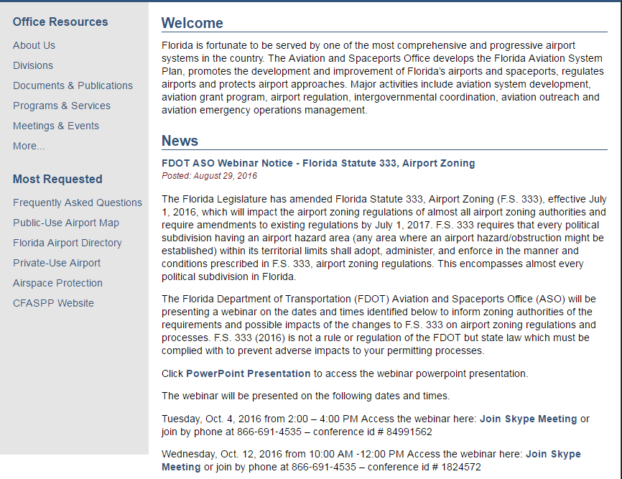

Slide 21
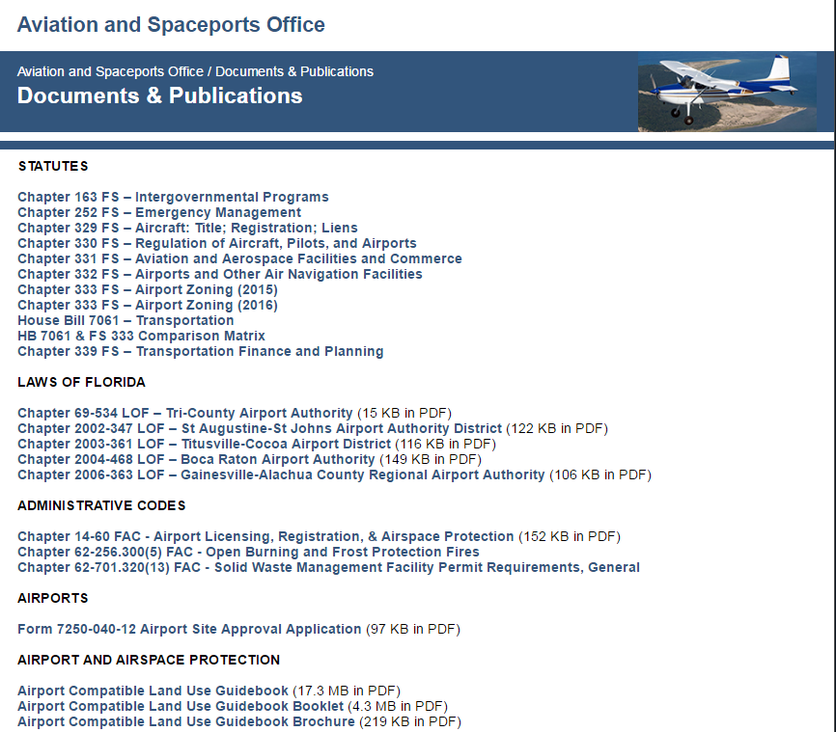

Slide 22
Sample of HB 7061 & FS 333 Comparison Matrix

Slide 23
F.S. 333.135(1) & (2)
FS 333.135(1)
Any airport zoning regulation in effect on July 1, 2016, which includes provisions in conflict with this chapter shall be amended to conform to the requirements of this chapter by July 1, 2017.
FS 333.135(2)
Any political subdivision having an airport within its territorial limits which has not adopted airport zoning regulations shall, by July 1, 2017, adopt airport zoning regulations consistent with this chapter.

Slide 24
COMPLIANCE WITH FEDERAL REQUIREMENTS FOR LOCAL ZONING
Florida Department of
TRANSPORTATION

Slide 25
Federal Standards for Airport Zoning
Title 14 Code of Federal Regulations Part 77

Slide 26
14 C.F.R. Part 77
Title 14: Aeronautics and Space Part 77-Safe, Efficient Use, Preservation of the Navigable Airspace Contents
Subpart A – General
Subpart B - Notice Requirements
Subpart C - Standards for Determining Obstructions to Air Navigation or Navigation Aids or Facilities
Subpart D - Aeronautical Studies and Determinations
Subpart E - Petitions for Discretionary Review

Slide 27
FAA Notice Requirements
14 C.F.R. Part 77 subpart B - Notice Requirements
Section 77.5
(a) If you propose any construction or alteration described in Section 77.9, you must provide adequate notice to the FAA of that construction or alteration.
(c) Notice received by the FAA under this subpart is used to:
evaluate the effect of the proposed construction or alteration on safety in air commerce and the efficient use and preservation of the navigable airspace and airport traffic capacity at public use airports;
Determine whether the effect of proposed construction or alteration is a hazard to air navigation.....

Slide 28
FAA Notice Requirements
14 C.F.R. Part 77 subpart B - Notice Requirements
Section 77.7
If you are required to file notice under 77.9, you must submit to the FAA a complete FAA Form 7460-1,Notice of Proposed Construction or Alteration.
You must submit this form at least 45 days before the start date of the proposed construction or alteration or the date an application for a construction permit is filed, whichever is earliest..........

Slide 29
FAA Notice Requirements
14 C.F.R. Part 77 subpart B - Notice Requirements
Section 77.9
If requested by the FAA, or if you propose any of the following types of construction or alteration, you must file notice with the FAA of: ……….

Slide 30
Helpful FAA Websites
FAA Notice Criteria Tool
  https://oeaaa.faa.gov/oeaaa/external/gisTools/gisAction.jsp?action=showNoNoticeRequiredToolForm
Obstruction Evaluation/Airport Airspace Analysis
  https://oeaaa.faa.gov/oeaaa/external/gisTools/gisAction.jsp

Slide 31
FAA Obstruction Standards
Title 14: Aeronautics and Space
Part 77 - Safe, Efficient Use, Preservation of the Navigable Airspace
Subpart C - Standards for Determining Obstructions to Air Navigation or Navigational Aids or Facilities
  Section 77.13 Applicability
  Section 77.15 Scope
  Section 77.17 Obstruction Standards
  Section 77.19 Civil airport imaginary surfaces
  Section 77.21 Department of Defense (DOD) airport imaginary surfaces
  Section 77.23 Heliport Imaginary surfaces

Slide 32
14 C.F.R. Part 77
Subpart C – Section 77.17, Obstruction Standards
(a) An existing object, including a mobile object, is, and a future object would be an obstruction to air navigation if it is of greater height than any of the following heights or surfaces:
(5) The surface of a takeoff and landing area of an airport or any imaginary surface established under §77.19, 77.21, or 77.23. However, no part of the takeoff or landing area itself will be considered an obstruction.

Slide 33
14 C.F.R. Part 77
Subpart C – Section 77.19, Civil Airport Imaginary Surfaces
The following civil airport imaginary surfaces are established with relation to the airport and to each runway. The size of each such imaginary surface is based on the category of each runway according to the type of approach available or planned for that runway. The slope and dimensions of the approach surface applied to each end of a runway are determined by the most precise approach procedure existing or planned for that runway end.
Horizontal surface ….
Conical surface ……
Primary surface ……
Approach surface ……
Transitional surface ….

Slide 34
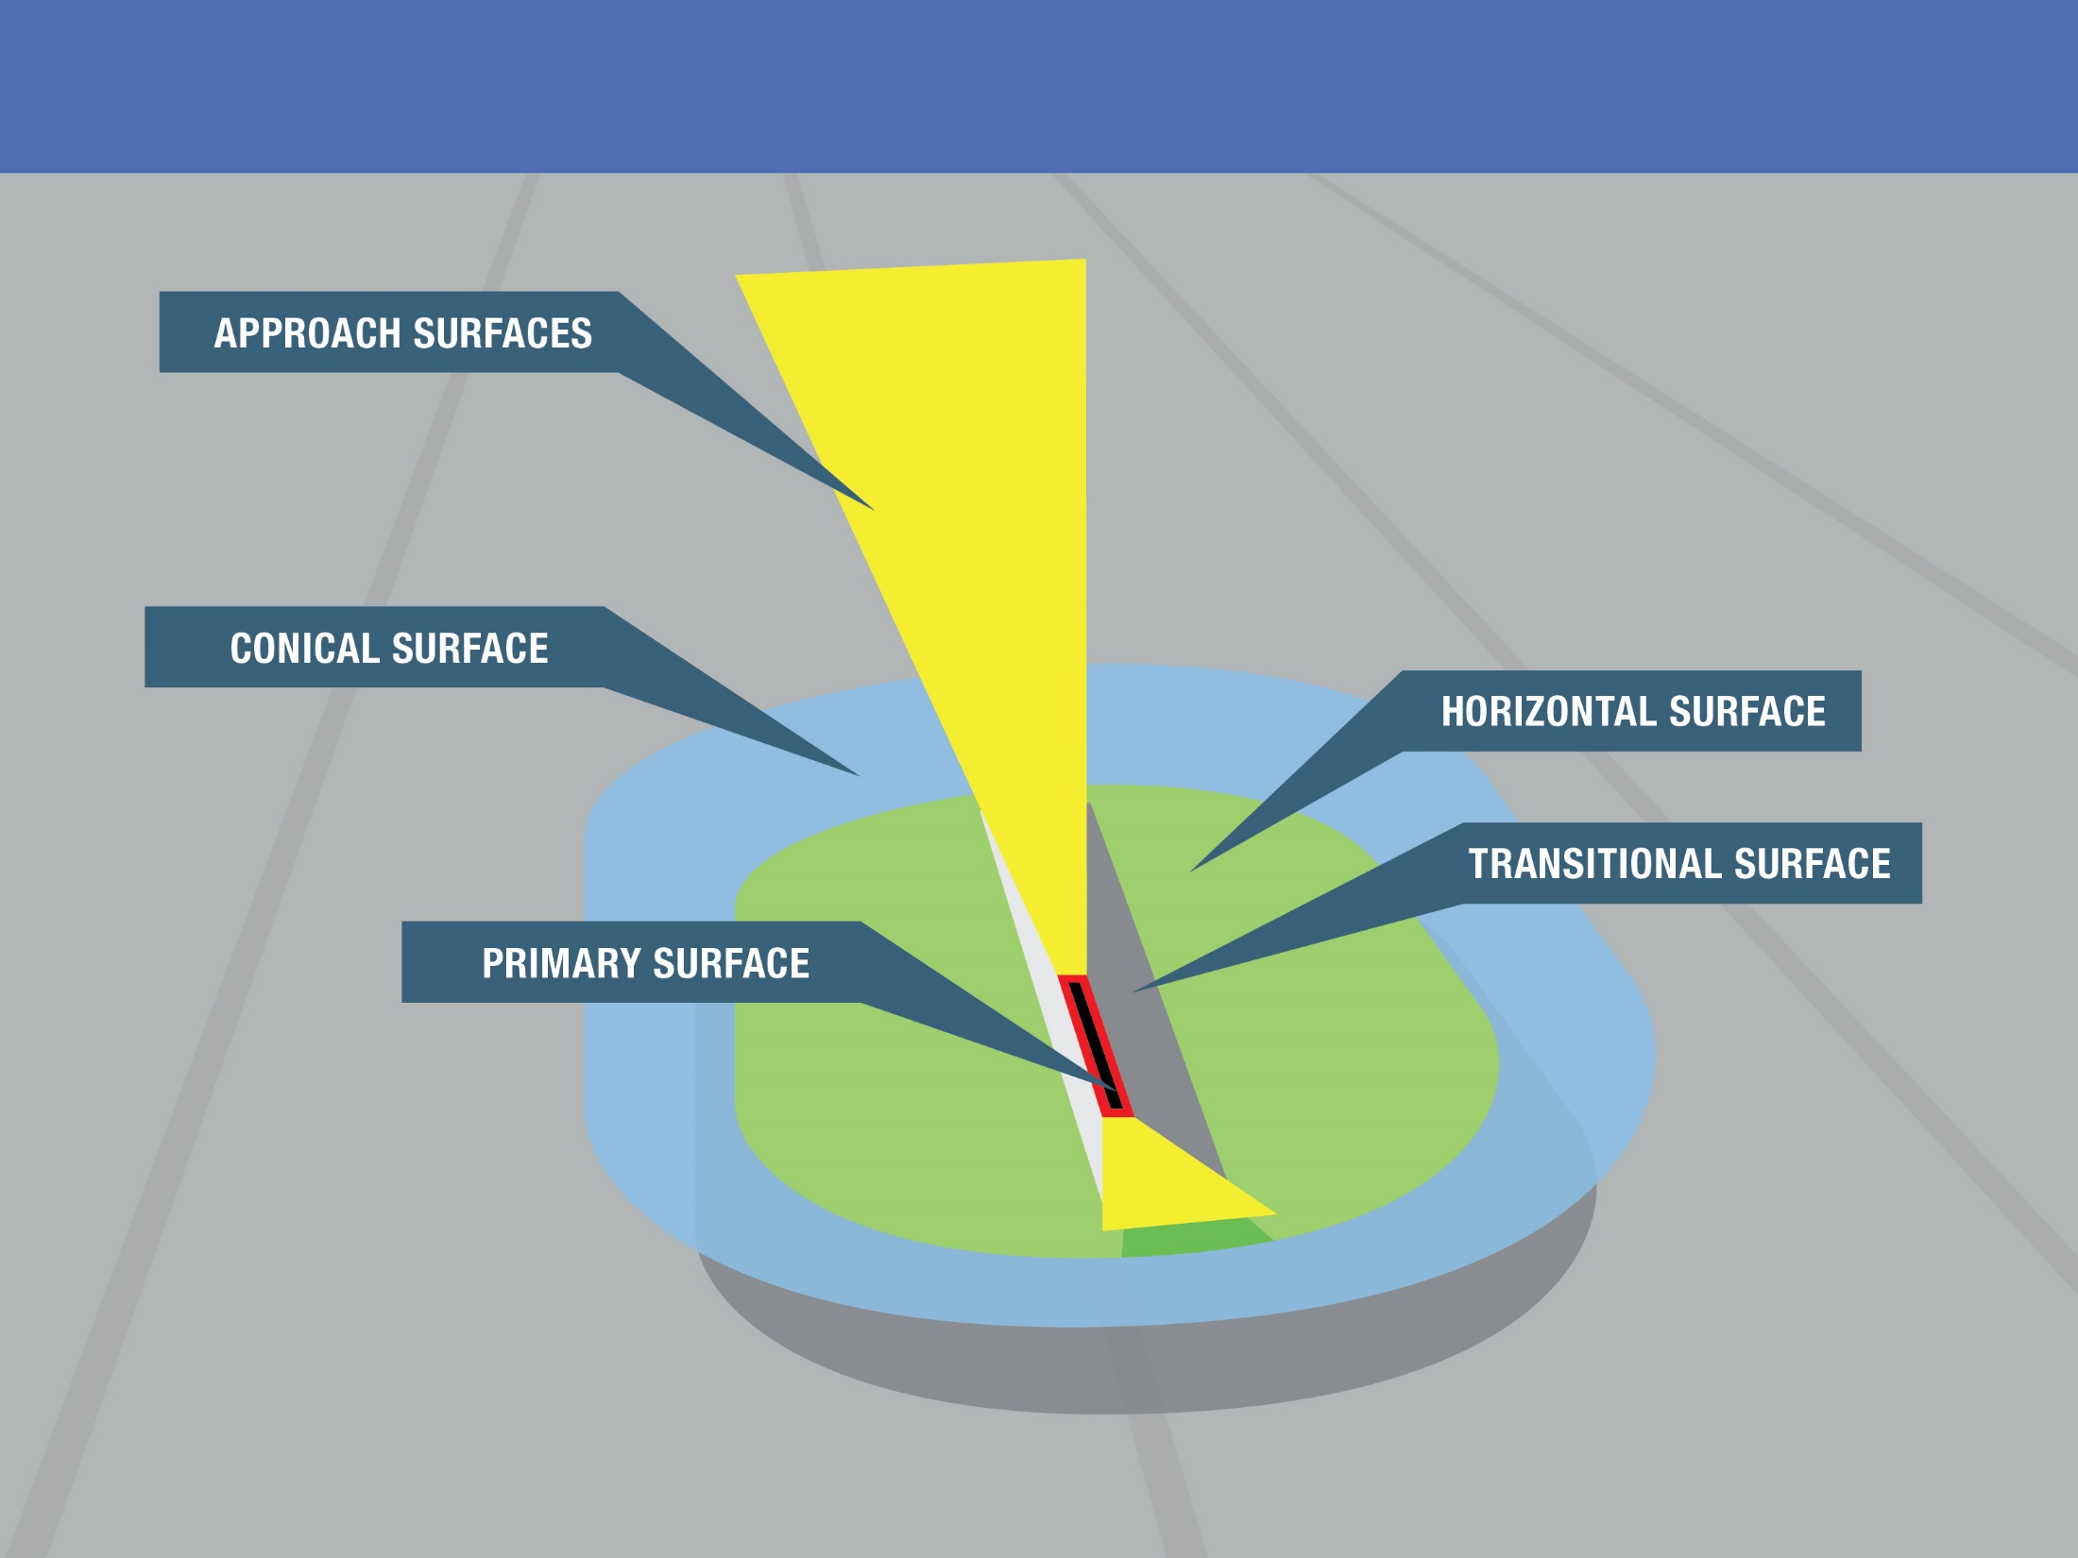
Part 77 Surfaces

Slide 35
Federal compliance required by
F.S. 333.03(1)(c )3.(below)
Documentation showing compliance with the federal requirement for notification of proposed construction or alteration of structures and a valid aeronautical study evaluation submitted by each person applying for a permit variance;
Documentation showing compliance with the federal requirement for notification of proposed construction or alteration of structures and a valid aeronautical study submitted by each person applying for a permit;

Slide 36
Comparison Matrix of HB 7061 and F.S. 333 (2016)
HB 7061
FS 333 (revised)

Slide 37
Chapter 333, F.S.
Table of Contents
333.01 - Definitions.
333.02 - Airport hazards and uses of land in airport vicinities contrary to public interest.
333.025 - Permit required for obstructions.
333.03 - Requirement to adopt airport zoning regulations.
333.04 - Comprehensive zoning regulations; most stringent to prevail where conflicts occur.
333.05 - Procedure for adoption of airport zoning regulations.
333.06 - Airport zoning regulation requirements.
333.07 - Local government permitting of airspace obstructions.
333.09 - Administration of airport protection zoning regulations.
333.11 - Judicial review.
333.12 - Acquisition of air rights.
333.13 - Enforcement and remedies.
333.135 - Transition provisions.

Slide 38
F.S. 333.01 Definitions
Florida Department of
TRANSPORTATION

Slide 39
333.01
Definitions.—As used in For the purpose of this chapter, the term following words, terms, and phrases shall have the meanings herein given, unless otherwise specifically defined, or unless another intention clearly appears, or the context otherwise requires:
Definitions.—As used in this chapter, the term:

Slide 40
333.01(12)(7)
"Obstruction" means any existing or proposed manmade object or object, of natural growth or terrain, or structure construction or alteration that exceeds violates the federal obstruction standards contained in 14 C.F.R. part 77, subpart C ss. 77.21, 77.23, 77.25, 77.28, and 77.29. The term includes:
"Obstruction" means any existing or proposed object, terrain, or structure construction or alteration that exceeds the federal obstruction standards contained in 14 C.F.R. part 77, subpart C. The term includes:

Slide 41
333.01(12)(a)
Any object of natural growth or terrain;
Any object of natural growth or terrain;

Slide 42
333.01(12)(b)
Permanent or temporary construction or alteration, including equipment or materials used and any permanent or temporary apparatus; or
Permanent or temporary construction or alteration, including equipment or materials used and any permanent or temporary apparatus; or

Slide 43
333.01(12)(c)
Alteration of any permanent or temporary existing structure by a change in the structure's height, including appurtenances, lateral dimensions, and equipment or materials used in the structure.
Alteration of any permanent or temporary existing structure by a change in the structure's height, including appurtenances, lateral dimensions, and equipment or materials used in the structure.

Slide 44
333.01(2)
"Airport" means any area of land or water designed and set aside for the landing and taking off of aircraft and used utilized or to be used utilized in the interest of the public for such purpose.
"Airport" means any area of land or water designed and set aside for the landing and taking off of aircraft and used or to be used in the interest of the public for such purpose.

Slide 45
333.01(3)
“Airport hazard” means an obstruction to air navigation which affects the safe and efficient use of navigable airspace or the operation of planned or existing air navigation and communication facilities any structure or tree or use of land which would exceed the federal obstruction standards as contained in 14 C.F.R. ss. 77.21, 77.23, 77.25, 77.28, and 77.29 and which obstructs the airspace required for the flight of aircraft in taking off, maneuvering, or landing or is otherwise hazardous to such taking off, maneuvering, or landing of aircraft and for which no person has previously obtained a permit or variance pursuant to s. 333.025 or s. 333.07.
“Airport hazard” means an obstruction to air navigation which affects the safe and efficient use of navigable airspace or the operation of planned or existing air navigation and communication facilities.

Slide 46
333.01(4)
“Airport hazard area” means any area of land or water upon which an airport hazard might be established if not prevented as provided in this chapter.
“Airport hazard area” means any area of land or water upon which an airport hazard might be established.

Slide 47
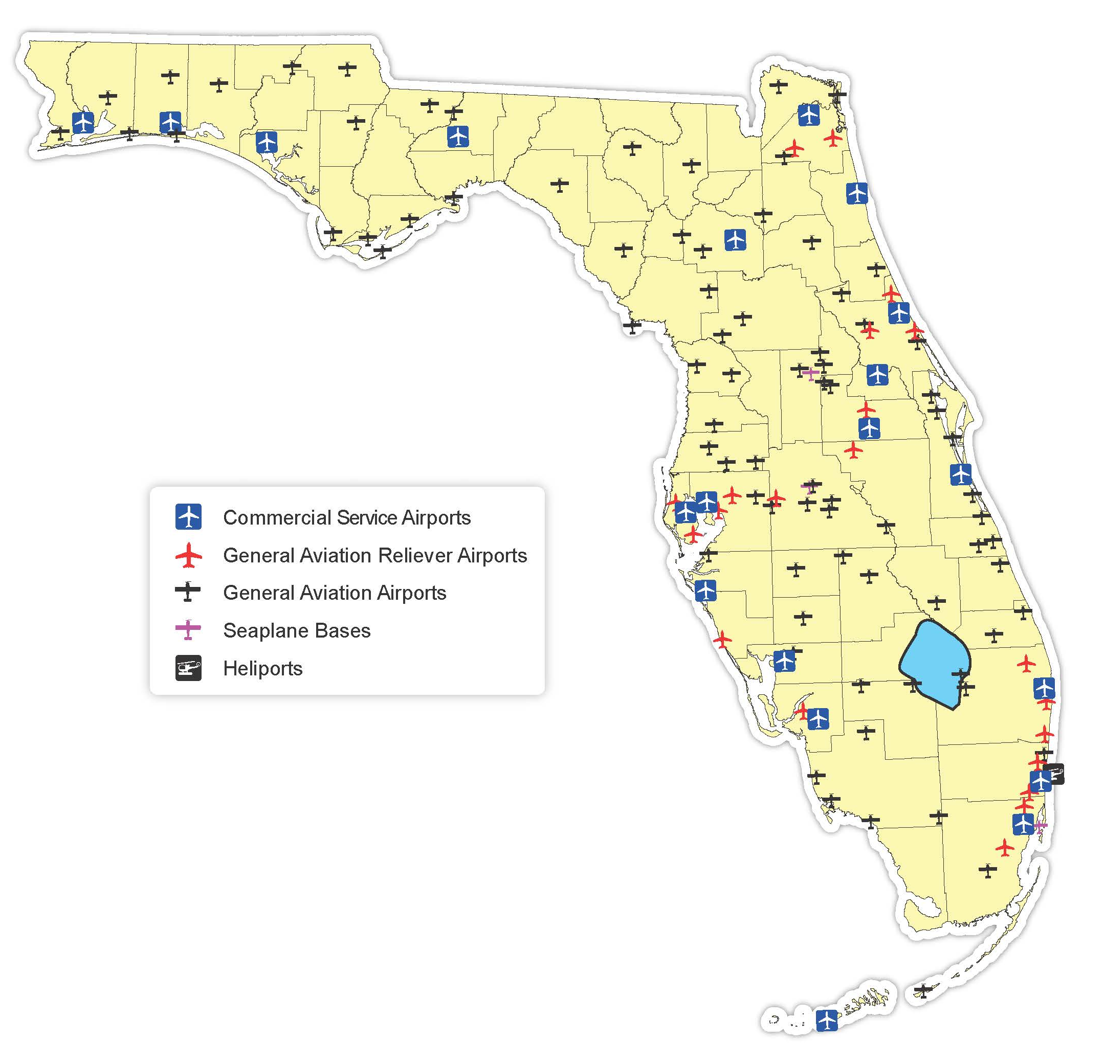

Slide 48
333.01(1)
“Aeronautical study” means a Federal Aviation Administration study, conducted in accordance with the standards of 14 C.F.R. part 77, subpart C, and Federal Aviation Administration policy and guidance, on the effect of proposed construction or alteration upon the operation of air navigation facilities and the safe and efficient use of navigable airspace. “Aeronautics” means transportation by aircraft; the operation, construction, repair, or maintenance of aircraft, aircraft power plants and accessories, including the repair, packing, and maintenance of parachutes; the design, establishment, construction, extension, operation, improvement, repair, or maintenance of airports, restricted landing areas, or other air navigation facilities, and air instruction.
“Aeronautical study” means a Federal Aviation Administration study, conducted in accordance with the standards of 14 C.F.R. part 77, subpart C, and Federal Aviation Administration policy and guidance, on the effect of proposed construction or alteration upon the operation of air navigation facilities and the safe and efficient use of navigable airspace.

Slide 49
333.01(8)
“Airport protection zoning regulations” means airport zoning regulations governing airport hazards.
“Airport protection zoning regulations” means airport zoning regulations governing airport hazards.

Slide 50
333.01(5)
“Airport land use compatibility zoning” means airport zoning regulations governing restricting the use of land on, adjacent to, or in the immediate vicinity of airports in the manner enumerated in s. 333.03(2) to activities and purposes compatible with the continuation of normal airport operations including landing and takeoff of aircraft in order to promote public health, safety, and general welfare.
“Airport land use compatibility zoning” means airport zoning regulations governing the use of land on, adjacent to, or in the immediate vicinity of airports.

Slide 51
333.01(6)
“Airport layout plan” means a set of scaled drawings that provide a graphic representation of the existing and future development plan for the airport and demonstrate the preservation and continuity of safety, utility, and efficiency of the airport detailed, scale engineering drawing, including pertinent dimensions, of an airport’s current and planned facilities, their locations, and runway usage.
“Airport layout plan” means a set of scaled drawings that provide a graphic representation of the existing and future development plan for the airport and demonstrate the preservation and continuity of safety, utility, and efficiency of the airport.

Slide 52
333.01(7)
“Airport master plan” means a comprehensive plan of an airport which typically describes current and future plans for airport development designed to support existing and future aviation demand.
“Airport master plan” means a comprehensive plan of an airport which typically describes current and future plans for airport development designed to support existing and future aviation demand.

Slide 53
333.01(9)
"Department" means the Department of Transportation as created under s. 20.23.
"Department" means the Department of Transportation as created under s. 20.23.

Slide 54
333.01(10)
“Educational facility” means any structure, land, or use that includes a public or private kindergarten through 12th grade school, charter school, magnet school, college campus, or university campus. The term does not include space used for educational purposes within a multi-tenant building.
“Educational facility” means any structure, land, or use that includes a public or private kindergarten through 12th grade school, charter school, magnet school, college campus, or university campus. The term does not include space used for educational purposes within a multi-tenant building.

Slide 55
333.01(11)
“Landfill” has the same meaning as provided in s. 403.703.
“Landfill” has the same meaning as provided in s. 403.703.

Slide 56
333.01(13)(8)
“Person” means any individual, firm, copartnership, corporation, company, association, joint-stock association, or body politic, and includes any trustee, receiver, assignee, or other similar representative thereof.
“Person” means any individual, firm, copartnership, corporation, company, association, joint-stock association, or body politic, and includes any trustee, receiver, assignee, or other similar representative thereof.

Slide 57
333.01(14)(9)
“Political subdivision” means the local government of any county, municipality city, town, village, or other subdivision or agency thereof, or any district or special district, port commission, port authority, or other such agency authorized to establish or operate airports in the state.
“Political subdivision” means the local government of any county, municipality, town, village, or other subdivision or agency thereof, or any district or special district, port commission, port authority, or other such agency authorized to establish or operate airports in the state.

Slide 58
333.01(15)
“Public-use airport” means an airport, publicly or privately owned, licensed by the state, which is open for use by the public.
“Public-use airport” means an airport, publicly or privately owned, licensed by the state, which is open for use by the public.

Slide 59
333.01(16)(10)
“Runway protection clear zone” means an area at ground level beyond the runway end to enhance the safety and protection of people and property on the ground a runway clear zone as defined in 14 C.F.R. s. 151.9(b).
“Runway protection zone” means an area at ground level beyond the runway end to enhance the safety and protection of people and property on the ground.

Slide 60
333.01(17)(11)
“Structure” means any object, constructed, erected, altered, or installed by humans, including, but not limited to without limitation thereof, buildings, towers, smokestacks, utility poles, power generation equipment, and overhead transmission lines.
“Structure” means any object constructed, erected, altered, or installed, including, but not limited to, buildings, towers, smokestacks, utility poles, power generation equipment, and overhead transmission lines.

Slide 61
333.01(18)
"Substantial modification" means any repair, reconstruction, rehabilitation, or improvement of a structure when the actual cost of the repair, reconstruction, rehabilitation, or improvement of the structure equals or exceeds 50 percent of the market value of the structure.
"Substantial modification" means any repair, reconstruction, rehabilitation, or improvement of a structure when the actual cost of the repair, reconstruction, rehabilitation, or improvement of the structure equals or exceeds 50 percent of the market value of the structure.

Slide 62
333.01(12)
“Tree” includes any plant of the vegetable kingdom.

Slide 63
FDOT AIRPORT ZONING PERMIT PROCEDURE

Slide 64
333.025
Permit required for obstructions structures exceeding federal obstruction standards.
Permit required for obstructions.

Slide 65
333.025(1)
A person proposing the construction or alteration In order to prevent the erection of an obstruction must obtain a permit from the department structures dangerous to air navigation, subject to the provisions of subsections (2), (3), and (4), each person shall secure from the Department of Transportation a permit for the erection, alteration, or modification of any structure the result of which would exceed the federal obstruction standards as contained in 14 C.F.R. ss. 77.21, 77.23, 77.25, 77.28, and 77.29. However, permits from the department of Transportation will be required only within an airport hazard area where federal obstruction standards are exceeded and if the proposed construction or alteration is within a 10-nautical-mile radius of the airport reference point, located at the approximate geometric geographical center of all usable runways of a public-use airport or a publicly owned or operated airport, a military airport, or an airport licensed by the state for public use.
A person proposing the construction or alteration of an obstruction must obtain a permit from the department, subject to subsections (2), (3), and (4). However, permits from the department will be required only within an airport hazard area where federal obstruction standards are exceeded and if the proposed construction or alteration is within a 10-nautical-mile radius of the airport reference point, located at the approximate geometric center of all usable runways of a public-use airport or military airport.

Slide 66
333.025(2)
Existing, planned, and proposed Affected airports will be considered as having those facilities on public-use airports contained in an which are shown on the airport master plan, in or an airport layout plan submitted to the Federal Aviation Administration, Airport District Office or in comparable military documents shall, and will be so protected from airport hazards. Planned or proposed public-use airports which are the subject of a notice or proposal submitted to the Federal Aviation Administration or to the Department of Transportation shall also be protected.
Existing, planned, and proposed facilities on public-use airports contained in an airport master plan, in an airport layout plan submitted to the Federal Aviation Administration, or in comparable military documents shall be protected from airport hazards.

Slide 67
333.025(3)
A permit is not required for existing structures that requirements of subsection (1) shall not apply to projects which received construction permits from the Federal Communications Commission for structures exceeding federal obstruction standards before prior to May 20, 1975, provided such structures now exist; a permit is not required for nor shall it apply to previously approved structures now existing, or any necessary replacement or repairs to such existing structures if, so long as the height and location are is unchanged.
A permit is not required for existing structures that received construction permits from the Federal Communications Commission for structures exceeding federal obstruction standards before May 20, 1975; a permit is not required for any necessary replacement or repairs to such existing structures if the height and location are unchanged.

Slide 68
333.025(4)
If When political subdivisions have, in compliance with this chapter, adopted adequate airport airspace protection zoning regulations, placed in compliance with s. 333.03, and such regulations are on file with the department's aviation office, and established a permitting process Department of Transportation, a permit for the construction or alteration of an obstruction is such structure shall not be required from the department of Transportation. Upon receipt of a complete permit application, the local government shall provide a copy of the application to the department's aviation office by certified mail, return receipt requested, or by a delivery service that provides a receipt evidencing delivery. To evaluate technical consistency with this subsection, the department shall have a 15-day review period following receipt of the application, which must run concurrently with the local government permitting process. Cranes, construction equipment, and other temporary structures in use or in place for a period not to exceed 18 consecutive months are exempt from the department's review, unless such review is requested by the department.
If political subdivisions have, in compliance with this chapter, adopted adequate airport protection zoning regulations, placed such regulations on file with the department's aviation office, and established a permitting process, a permit for the construction or alteration of an obstruction is not required from the department. Upon receipt of a complete permit application, the local government shall provide a copy of the application to the department's aviation office by certified mail, return receipt requested, or by a delivery service that provides a receipt evidencing delivery. To evaluate technical consistency with this subsection, the department shall have a 15-day review period following receipt of the application, which must run concurrently with the local government permitting process. Cranes, construction equipment, and other temporary structures in use or in place for a period not to exceed 18 consecutive months are exempt from the department's review, unless such review is requested by the department.

Slide 69
333.025(5)
The department of Transportation shall, within 30 days after of the receipt of an application for a permit, issue or deny a permit for the construction or erection, alteration, or modification of an obstruction any structure the result of which would exceed federal obstruction standards as contained in 14 C.F.R. ss. 77.21, 77.23, 77.25, 77.28, and 77.29. The department shall review permit applications in conformity with s. 120.60.
The department shall, within 30 days after receipt of an application for a permit, issue or deny a permit for the construction or alteration of an obstruction. The department shall review permit applications in conformity with s. 120.60.

Slide 70
CRITERIA DOT SHALL CONSIDER FOR PERMIT

Slide 71
333.025(6)
In determining whether to issue or deny a permit, the department shall consider:
In determining whether to issue or deny a permit, the department shall consider:

Slide 72
333.025(6)(a)
The safety of persons on the ground and in the air.
The safety of persons on the ground and in the air.

Slide 73
333.025(6)(b)
The safe and efficient use of navigable airspace.
The safe and efficient use of navigable airspace.

Slide 74
333.025(6)(c )
The nature of the terrain and height of existing structures.
The nature of the terrain and height of existing structures.

Slide 75
333.025(6)(d)
The effect of the construction or alteration of an obstruction on the state licensing standards for a public-use airport contained in chapter 330 and rules adopted thereunder.
The effect of the construction or alteration of an obstruction on the state licensing standards for a public-use airport contained in chapter 330 and rules adopted thereunder.

Slide 76
333.025(6)(e )(c )
The character of existing and planned flight flying operations and planned developments at public-use of airports.
The character of existing and planned flight operations and developments at public-use airports.

Slide 77
333.025(6)(f)(d)
Federal airways, visual flight rules, flyways and corridors, and instrument approaches as designated by the Federal Aviation Administration.
Federal airways, visual flight rules, flyways and corridors, and instrument approaches as designated by the Federal Aviation Administration.

Slide 78
333.025(6)(g)(e)
The effect of Whether the construction or alteration of an obstruction on the proposed structure would cause an increase in the minimum descent altitude or the decision height at the affected airport.
The effect of the construction or alteration of an obstruction on the minimum descent altitude or the decision height at the affected airport.

Slide 79
333.025(6)(h)(j)
The cumulative effects on navigable airspace of all existing obstructions structures, proposed structures identified in the applicable jurisdictions’ comprehensive plans, and all other known proposed obstructions structures in the area.
The cumulative effects on navigable airspace of all existing obstructions and all known proposed obstructions in the area.

Slide 80
333.025(6)(b)
Public and private interests and investments.

Slide 81
333.025(6)(f)
Technological advances.

Slide 82
333.025(6)(g)
The safety of persons on the ground and in the air.

Slide 83
333.025(6)(h)
Land use density.

Slide 84
333.025(6)(i)
The safe and efficient use of navigable airspace.

Slide 85
OTHER DOT PERMIT REQUIREMENTS

Slide 86
333.025(7)
When issuing a permit under this section, the department of Transportation shall, as a specific condition of such permit, require the owner obstruction marking and lighting of the obstruction to install, operate, and maintain, at the owner's expense, marking and lighting in conformance with the specific standards established by the Federal Aviation Administration permitted structure as provided in s. 333.07(3)(b).
When issuing a permit under this section, the department shall require the owner of the obstruction to install, operate, and maintain, at the owner's expense, marking and lighting in conformance with the specific standards established by the Federal Aviation Administration.

Slide 87
333.025(8)
The department may of Transportation shall not approve a permit for the construction or alteration erection of an obstruction a structure unless the applicant submits both documentation showing both compliance with the federal requirement for notification of proposed construction or alteration and a valid aeronautical study. A evaluation, and no permit may not shall be approved solely on the basis that the Federal Aviation Administration determined that the such proposed construction or alteration of an obstruction was not an airport hazard structure will not exceed federal obstruction standards as contained in 14 C.F.R. ss. 77.21, 77.23, 77.25, 77.28, or 77.29, or any other federal aviation regulation.
The department may not approve a permit for the construction or alteration of an obstruction unless the applicant submits documentation showing both compliance with the federal requirement for notification of proposed construction or alteration and a valid aeronautical study. A permit may not be approved solely on the basis that the Federal Aviation Administration determined that the proposed construction or alteration of an obstruction was not an airport hazard.

Slide 88
333.025(9)
The denial of a permit under this section is subject to administrative review pursuant to chapter 120.
The denial of a permit under this section is subject to administrative review pursuant to chapter 120.

Slide 89
333.03(1)(d)
The department shall be available to provide assistance to political subdivisions regarding federal obstruction standards shall issue copies of the federal obstruction standards as contained in 14 C.F.R. ss. 77.21, 77.23, 77.25, 77.28, and 77.29 to each political subdivision having airport hazard areas and, in cooperation with political subdivisions, shall issue appropriate airport zoning maps depicting within each county the maximum allowable height of any structure or tree. Material distributed pursuant to this subsection shall be at no cost to authorized recipients.
The department shall be available to provide assistance to political subdivisions regarding federal obstruction standards.

Slide 90
Political Subdivision Requirements For Airport Zoning Regulations

Slide 91
333.03
Requirement Power to adopt airport zoning regulations.
Requirement to adopt airport zoning regulations.

Slide 92
333.03(1)(a)
In order to prevent the creation or establishment of airport hazards, Every political subdivision having an airport hazard area within its territorial limits shall, by October 1, 1977, adopt, administer, and enforce, under the police power and in the manner and upon the conditions hereinafter prescribed in this section, airport protection zoning regulations for such airport hazard area.
Every political subdivision having an airport hazard area within its territorial limits shall adopt, administer, and enforce, under the police power and in the manner and upon the conditions prescribed in this section, airport protection zoning regulations for such airport hazard area.

Slide 93
333.03(1)(b)
If Where an airport is owned or controlled by a political subdivision and if any other political subdivision has land upon which an obstruction may be constructed or altered which underlies any surface of the airport as provided in 14 C.F.R. part 77, subpart C, the political subdivisions airport hazard area appertaining to such airport is located wholly or partly outside the territorial limits of said political subdivision, the political subdivision owning or controlling the airport and the political subdivision within which the airport hazard area is located, shall either:
If an airport is owned or controlled by a political subdivision and if any other political subdivision has land upon which an obstruction may be constructed or altered which underlies any surface of the airport as provided in 14 C.F.R. part 77, subpart C, the political subdivisions shall either:

Slide 94
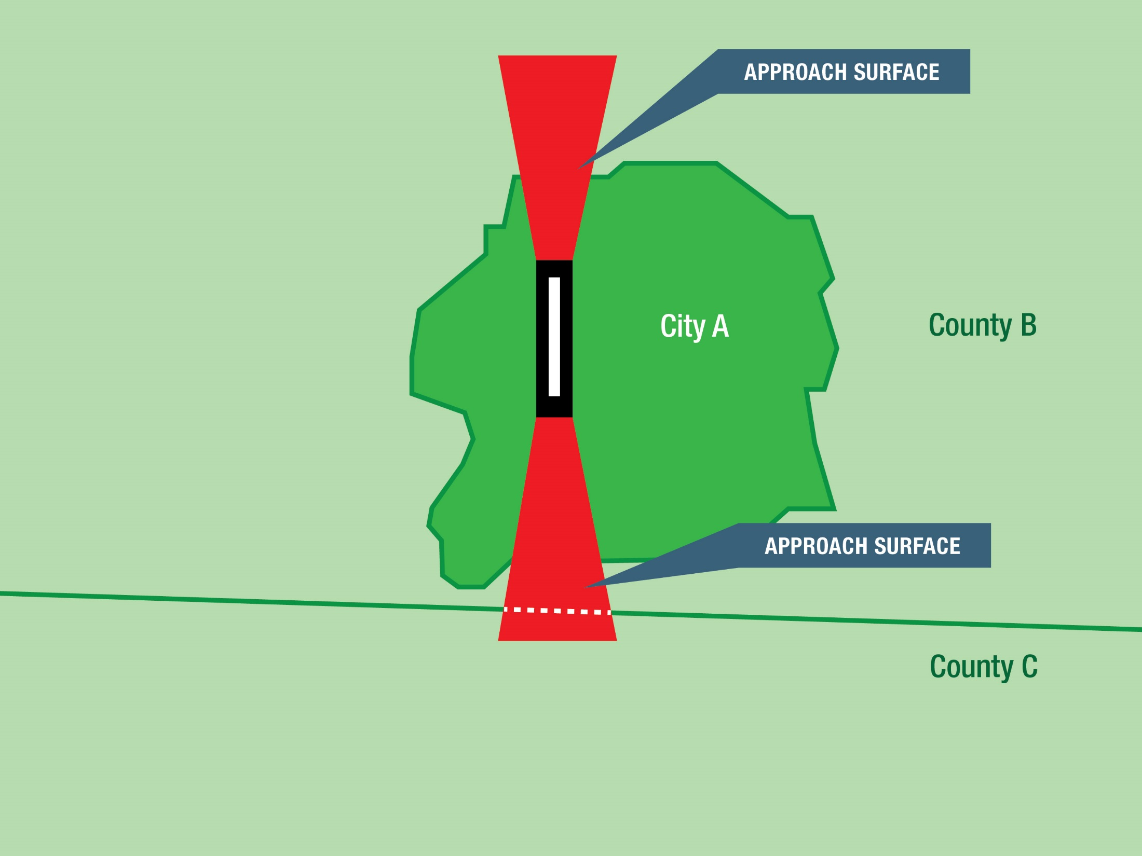

Slide 95
333.03(1)(b)1.
By interlocal agreement, in accordance with the provisions of chapter 163, adopt, administer, and enforce a set of airport protection zoning regulations applicable to the airport hazard area in question; or
By interlocal agreement, adopt, administer, and enforce a set of airport protection zoning regulations; or

Slide 96
333.03(1)(b)2.
By ordinance, regulation, or resolution duly adopted, create a joint airport protection zoning board that, which board shall have the same power to adopt, administer, and enforce a set of airport protection zoning regulations applicable to the airport hazard area in question as that vested in paragraph (a) in the political subdivision within which such area is located. The Each such joint airport protection zoning board shall have as voting members two representatives appointed by each participating political subdivision participating in its creation and in addition a chair elected by a majority of the members so appointed. However, The airport manager or a representative of each airport in managers of the affected participating political subdivisions shall serve on the board in a nonvoting capacity.
By ordinance, regulation, or resolution duly adopted, create a joint airport protection zoning board that shall adopt, administer, and enforce a set of airport protection zoning regulations.
The joint airport protection zoning board shall have as voting members two representatives appointed by each participating political subdivision and a chair elected by a majority of the members so appointed.
The airport manager or a representative of each airport in the affected participating political subdivisions shall serve on the board in a nonvoting capacity.

Slide 97
Political Subdivision Zoning Regulation Requirements

Slide 98
333.03(1)(c)
Airport protection zoning regulations adopted under paragraph (a) must shall, at as a minimum, require:
Airport protection zoning regulations adopted under paragraph (a) must, at a minimum, require:

Slide 99
333.03(1)(c )1.
A permit variance for the construction or erection, alteration, or modification of any obstruction structure which would cause the structure to exceed the federal obstruction standards as contained in 14 C.F.R. ss. 77.21, 77.23, 77.25, 77.28, and 77.29;
A permit for the construction or alteration of any obstruction;

Slide 100
333.03(1)(c )2.
Obstruction marking and lighting for obstructions structures as specified in s. 333.07(3);
Obstruction marking and lighting for obstructions;

Slide 101
333.03(1)(c )3.
Documentation showing compliance with the federal requirement for notification of proposed construction or alteration of structures and a valid aeronautical study evaluation submitted by each person applying for a permit variance;
Documentation showing compliance with the federal requirement for notification of proposed construction or alteration of structures and a valid aeronautical study submitted by each person applying for a permit;

Slide 102
333.03(1)(c )4.
Consideration of the criteria in s. 333.025(6), when determining whether to issue or deny a permit variance; and
Consideration of the criteria in s. 333.025(6), when determining whether to issue or deny a permit; and

Slide 103
333.03(1)(c )5.
That approval of a permit not be based no variance shall be approved solely on the determination by the Federal Aviation Administration basis that the such proposed structure is not an airport hazard will not exceed federal obstruction standards as contained in 14 C.F.R. ss. 77.21, 77.23, 77.25, 77.28, or 77.29, or any other federal aviation regulation.
That approval of a permit not be based solely on the determination by the Federal Aviation Administration that the proposed structure is not an airport hazard.

Slide 104
Land Use Compatibility Zoning Regulations

Slide 105
333.03(2)
In the manner provided in subsection (1), political subdivisions shall adopt, administer, and enforce interim airport land use compatibility zoning regulations shall be adopted. Airport land use compatibility zoning When political subdivisions have adopted land development regulations shall, at a minimum, in accordance with the provisions of chapter 163 which address the use of land in the manner consistent with the provisions herein, adoption of airport land use compatibility regulations pursuant to this subsection shall not be required. Interim airport land use compatibility zoning regulations shall consider the following:
In the manner provided in subsection (1), political subdivisions shall adopt, administer, and enforce airport land use compatibility zoning regulations. Airport land use compatibility zoning regulations shall, at a minimum, address the following:

Slide 106
333.03(2)(a)
The prohibition of new landfills and the restriction of existing landfills Whether sanitary landfills are located within the following areas:
The prohibition of new landfills and the restriction of existing landfills within the following areas:

Slide 107
333.03(2)(a)1.
Within 10,000 feet from the nearest point of any runway used or planned to be used by turbine turbojet or turboprop aircraft.
Within 10,000 feet from the nearest point of any runway used or planned to be used by turbine aircraft.

Slide 108
333.03(2)(a)2.
Within 5,000 feet from the nearest point of any runway used only by only nonturbine piston-type aircraft.
Within 5,000 feet from the nearest point of any runway used by only nonturbine aircraft.

Slide 109
333.03(2)(a)3.
Outside the perimeters defined in subparagraphs 1. and 2., but still within the lateral limits of the civil airport imaginary surfaces defined in 14 C.F.R. s. 77.19 part 77.25. Case-by-case review of such landfills is advised.
Outside the perimeters defined in subparagraphs 1. and 2., but still within the lateral limits of the civil airport imaginary surfaces defined in 14 C.F.R. s. 77.19. Case-by-case review of such landfills is advised.

Slide 110
333.03(2)(b)
Where Whether any landfill is located and constructed in a manner so that it attracts or sustains hazardous bird movements from feeding, water, or roosting areas into, or across, the runways or approach and departure patterns of aircraft. The landfill operator must political subdivision shall request from the airport authority or other governing body operating the airport a report on such bird feeding or roosting areas that at the time of the request are known to the airport. In preparing its report, the authority, or other governing body, shall consider whether the landfill will incorporate bird management techniques or other practices to minimize bird hazards to airborne aircraft. The airport authority or other governing body shall respond to the political subdivision no later than 30 days after receipt of such request.
Where any landfill is located and constructed in a manner that attracts or sustains hazardous bird movements from feeding, water, or roosting areas into, or across, the runways or approach and departure patterns of aircraft. The landfill operator must incorporate bird management techniques or other practices to minimize bird hazards to airborne aircraft.

Slide 111
333.03(2)(c )
Where an airport authority or other governing body operating a publicly owned, public-use airport has conducted a noise study in accordance with the provisions of 14 C.F.R. part 150, or where a public-use airport owner has established noise contours pursuant to another public study approved by the Federal Aviation Administration, the prohibition of incompatible uses, as established in the noise study in 14 C.F.R. part 150, Appendix A or as a part of an alternative Federal Aviation Administration-approved public study, within the noise contours established by any of these studies, except if such uses are specifically contemplated by such study with appropriate mitigation or similar techniques described in the study neither residential construction nor any educational facility as defined in chapter 1013, with the exception of aviation school facilities, shall be permitted within the area contiguous to the airport defined by an outer noise contour that is considered incompatible with that type of construction by 14 C.F.R. part 150, Appendix A or an equivalent noise level as established by other types of noise studies.
Where an airport authority or other governing body operating a public-use airport has conducted a noise study in accordance with 14 C.F.R. part 150, or where a public-use airport owner has established noise contours pursuant to another public study approved by the Federal Aviation Administration, the prohibition of incompatible uses, as established in the noise study in 14 C.F.R. part 150, Appendix A or as a part of an alternative Federal Aviation Administration-approved public study, within the noise contours established by any of these studies, except if such uses are specifically contemplated by such study with appropriate mitigation or similar techniques described in the study.

Slide 112
333.03(2)(d)
Where an airport authority or other governing body operating a publicly owned, public-use airport has not conducted a noise study, the prohibition of neither residential construction and nor any educational facility as defined in chapter 1013, with the exception of aviation school facilities, shall be permitted within an area contiguous to the airport measuring one-half the length of the longest runway on either side of and at the end of each runway centerline.
Where an airport authority or other governing body operating a public-use airport has not conducted a noise study, the prohibition of residential construction and any educational facility, with the exception of aviation school facilities, within an area contiguous to the airport measuring one-half the length of the longest runway on either side of and at the end of each runway centerline.

Slide 113
333.03(2)(e )(3)
The restriction of In the manner provided in subsection (1), airport zoning regulations shall be adopted which restrict new incompatible uses, activities, or substantial modifications to existing incompatible uses construction within runway protection clear zones, including uses, activities, or construction in runway clear zones which are incompatible with normal airport operations or endanger public health, safety, and welfare by resulting in congregations of people, emissions of light or smoke, or attraction of birds. Such regulations shall prohibit the construction of an educational facility of a public or private school at either end of a runway of a publicly owned, public-use airport within an area which extends 5 miles in a direct line along the centerline of the runway, and which has a width measuring one-half the length of the runway. Exceptions approving construction of an educational facility within the delineated area shall only be granted when the political subdivision administering the zoning regulations makes specific findings detailing how the public policy reasons for allowing the construction outweigh health and safety concerns prohibiting such a location.
The restriction of new incompatible uses, activities, or substantial modifications to existing incompatible uses within runway protection zones.

Slide 114
333.03(4)
The procedures outlined in subsections (1), (2), and (3) for the adoption of such regulations are supplemental to any existing procedures utilized by political subdivisions in the adoption of such regulations.
(deleted)

Slide 115
333.03(3)(5)
Political subdivisions shall provide The Department of Transportation shall provide technical assistance to any political subdivision requesting assistance in the preparation of an airport zoning code. a copy of all local airport protection zoning codes, rules, and regulations and airport land use compatibility zoning regulations, and any related amendments and proposed and granted variances thereto, to shall be filed with the department's aviation office within 30 days after adoption department.
Political subdivisions shall provide a copy of all airport protection zoning regulations and airport land use compatibility zoning regulations, and any related amendments, to the department's aviation office within 30 days after adoption.

Slide 116
333.03(4)(6)
Nothing in Subsection (2) may not or subsection (3) shall be construed to require the removal, alteration, sound conditioning, or other change, or to interfere with the continued use or adjacent expansion of any educational facility structure or site in existence on July 1, 1993, or be construed to prohibit the construction of any new structure for which a site has been determined as provided in former s. 235.19, as of July 1, 1993.
Subsection (2) may not be construed to require the removal, alteration, sound conditioning, or other change, or to interfere with the continued use or adjacent expansion of any educational facility or site in existence on July 1, 1993.

Slide 117
333.03(5)
This section does not prohibit an airport authority, a political subdivision or its administrative agency, or any other governing body operating a public-use airport from establishing airport zoning regulations more restrictive than prescribed in this section in order to protect the health, safety, and welfare of the public in the air and on the ground.
This section does not prohibit an airport authority, a political subdivision or its administrative agency, or any other governing body operating a public-use airport from establishing airport zoning regulations more restrictive than prescribed in this section in order to protect the health, safety, and welfare of the public in the air and on the ground.

Slide 118
Comprehensive Zoning Regulations: Incorporation and Conflict

Slide 119
333.04
Comprehensive zoning regulations; most stringent to prevail where conflicts occur.
Comprehensive zoning regulations; most stringent to prevail where conflicts occur.

Slide 120
333.04(1)
INCORPORATION.—In the event that a political subdivision has adopted, or hereafter adopts, a comprehensive plan or policy zoning ordinance regulating, among other things, the height of buildings, structures, and natural objects, and uses of property, any airport zoning regulations applicable to the same area or portion thereof may be incorporated in and made a part of such comprehensive plan or policy zoning regulations, and be administered and enforced in connection therewith.
INCORPORATION.—In the event that a political subdivision has adopted, or hereafter adopts, a comprehensive plan or policy regulating, among other things, the height of buildings, structures, and natural objects, and uses of property, any airport zoning regulations applicable to the same area or portion thereof may be incorporated in and made a part of such comprehensive plan or policy, and be administered and enforced in connection therewith.

Slide 121
333.04(2)
CONFLICT.—In the event of conflict between any airport zoning regulations adopted under this chapter and any other regulations applicable to the same area, whether the conflict be with respect to the height of structures or vegetation trees, the use of land, or any other matter, and whether such regulations were adopted by the political subdivision that which adopted the airport zoning regulations or by some other political subdivision, the more stringent limitation or requirement shall govern and prevail.
CONFLICT.—In the event of conflict between any airport zoning regulations adopted under this chapter and any other regulations applicable to the same area, whether the conflict be with respect to the height of structures or vegetation, the use of land, or any other matter, and whether such regulations were adopted by the political subdivision that adopted the airport zoning regulations or by some other political subdivision, the more stringent limitation or requirement shall govern and prevail.

Slide 122
PROCEDURE FOR ADOPTION OF AIRPORT ZONING REGULATIONS

Slide 123
333.05
Procedure for adoption of airport zoning regulations.—
Procedure for adoption of airport zoning regulations.—

Slide 124
333.05(1)
NOTICE AND HEARING.—No Airport zoning regulations may not shall be adopted, amended, or repealed changed under this chapter except by action of the legislative body of the political subdivision or affected subdivisions in question, or the joint board provided in s. 333.03(1)(b)2. s. 333.03(1)(b) by the political subdivisions bodies therein provided and set forth, after a public hearing in relation thereto, at which parties in interest and citizens shall have an opportunity to be heard. Notice of the hearing shall be published at least once a week for 2 consecutive weeks in a newspaper an official paper, or a paper of general circulation, in the political subdivision or subdivisions where in which are located the airport zoning regulations are areas to be adopted, amended, or repealed zoned.
NOTICE AND HEARING.—Airport zoning regulations may not be adopted, amended, or repealed under this chapter except by action of the legislative body of the political subdivision or affected subdivisions, or the joint board provided in s. 333.03(1)(b)2. by the political subdivisions therein provided and set forth, after a public hearing in relation thereto, at which parties in interest and citizens shall have an opportunity to be heard. Notice of the hearing shall be published at least once a week for 2 consecutive weeks in a newspaper of general circulation in the political subdivision or subdivisions where the airport zoning regulations are to be adopted, amended, or repealed.

Slide 125
333.05(2)
AIRPORT ZONING COMMISSION.—Before Prior to the initial zoning of any airport area under this chapter, the political subdivision or joint airport zoning board that which is to adopt, administer, and enforce the regulations must shall appoint a commission, to be known as the airport zoning commission, to recommend the boundaries of the various zones to be established and the regulations to be adopted therefor. Such commission shall make a preliminary report and hold public hearings thereon before submitting its final report, and the legislative body of the political subdivision or the joint airport zoning board may shall not hold its public hearings or take any action until it has received the final report of such commission, and at least 15 days shall elapse between the receipt of the final report of the commission and the hearing to be held by the latter board. If Where a planning city plan commission, an airport commission, or a comprehensive zoning commission already exists, it may be appointed as the airport zoning commission.
AIRPORT ZONING COMMISSION.—Before the initial zoning of any airport area under this chapter, the political subdivision or joint airport zoning board that is to adopt, administer, and enforce the regulations must appoint a commission, to be known as the airport zoning commission, to recommend the boundaries of the various zones to be established and the regulations to be adopted therefor. Such commission shall make a preliminary report and hold public hearings thereon before submitting its final report, and the legislative body of the political subdivision or the joint airport zoning board may not hold its public hearings or take any action until it has received the final report of such commission, and at least 15 days shall elapse between the receipt of the final report of the commission and the hearing to be held by the latter board. If a planning commission, an airport commission, or a comprehensive zoning commission already exists, it may be appointed as the airport zoning commission.

Slide 126
333.06
Airport zoning regulation requirements.—
Airport zoning regulation requirements.—

Slide 127
333.06(1)
REASONABLENESS.—All airport zoning regulations adopted under this chapter shall be reasonable and may not none shall impose any requirement or restriction which is not reasonably necessary to effectuate the purposes of this chapter. In determining what regulations it may adopt, each political subdivision and joint airport zoning board shall consider, among other things, the character of the flying operations expected to be conducted at the airport, the nature of the terrain within the airport hazard area and runway protection clear zones, the character of the neighborhood, the uses to which the property to be zoned is put and adaptable, and the impact of any new use, activity, or construction on the airport's operating capability and capacity.
REASONABLENESS.—All airport zoning regulations adopted under this chapter shall be reasonable and may not impose any requirement or restriction which is not reasonably necessary to effectuate the purposes of this chapter. In determining what regulations it may adopt, each political subdivision and joint airport zoning board shall consider, among other things, the character of the flying operations expected to be conducted at the airport, the nature of the terrain within the airport hazard area and runway protection zones, the character of the neighborhood, the uses to which the property to be zoned is put and adaptable, and the impact of any new use, activity, or construction on the airport's operating capability and capacity.

Slide 128
333.06(2)
INDEPENDENT JUSTIFICATION.—The purpose of all airport zoning regulations adopted under this chapter is to provide both airspace protection and land uses use compatible with airport operations. Each aspect of this purpose requires independent justification in order to promote the public interest in safety, health, and general welfare. Specifically, construction in a runway protection clear zone which does not exceed airspace height restrictions is not conclusive evidence per se that such use, activity, or construction is compatible with airport operations.
INDEPENDENT JUSTIFICATION.—The purpose of all airport zoning regulations adopted under this chapter is to provide both airspace protection and land uses compatible with airport operations. Each aspect of this purpose requires independent justification in order to promote the public interest in safety, health, and general welfare. Specifically, construction in a runway protection zone which does not exceed airspace height restrictions is not conclusive that such use, activity, or construction is compatible with airport operations.

Slide 129
333.06(3)
NONCONFORMING USES.—An No airport protection zoning regulation regulations adopted under this chapter may not shall require the removal, lowering, or other change or alteration of any obstruction structure or tree not conforming to the regulation regulations when adopted or amended, or otherwise interfere with the continuance of any nonconforming use, except as provided in s. 333.07(1) and (3).
NONCONFORMING USES.—An airport protection zoning regulation adopted under this chapter may not require the removal, lowering, or other change or alteration of any obstruction not conforming to the regulation when adopted or amended, or otherwise interfere with the continuance of any nonconforming use, except as provided in s. 333.07(1) and (3).

Slide 130
333.06(4)
ADOPTION OF AIRPORT MASTER PLAN AND NOTICE TO AFFECTED LOCAL GOVERNMENTS.—An airport master plan shall be prepared by each public-use publicly owned and operated airport licensed by the department of Transportation under chapter 330. The authorized entity having responsibility for governing the operation of the airport, when either requesting from or submitting to a state or federal governmental agency with funding or approval jurisdiction a "finding of no significant impact," an environmental assessment, a site-selection study, an airport master plan, or any amendment to an airport master plan, shall submit simultaneously a copy of said request, submittal, assessment, study, plan, or amendments by certified mail to all affected local governments. As used in For the purposes of this subsection, the term "affected local government" is defined as any municipality city or county having jurisdiction over the airport and any municipality city or county located within 2 miles of the boundaries of the land subject to the airport master plan.
ADOPTION OF AIRPORT MASTER PLAN AND NOTICE TO AFFECTED LOCAL GOVERNMENTS.—An airport master plan shall be prepared by each public-use airport licensed by the department under chapter 330. The authorized entity having responsibility for governing the operation of the airport, when either requesting from or submitting to a state or federal governmental agency with funding or approval jurisdiction a "finding of no significant impact," an environmental assessment, a site-selection study, an airport master plan, or any amendment to an airport master plan, shall submit simultaneously a copy of said request, submittal, assessment, study, plan, or amendments by certified mail to all affected local governments. As used in this subsection, the term "affected local government" is defined as any municipality or county having jurisdiction over the airport and any municipality or county located within 2 miles of the boundaries of the land subject to the airport master plan.

Slide 131
POLITICAL SUBDIVISION PERMITTING OF AIRSPACE OBSTRUCTIONS

Slide 132
333.07
Local government permitting of airspace obstructions Permits and variances.—
Local government permitting of airspace obstructions.—

Slide 133
333.07(1)
PERMITS.—
PERMITS.—

Slide 134
333.07(1)(a)
A person proposing to construct, alter, or allow an airport obstruction in an airport hazard area in violation of the airport protection zoning regulations adopted under this chapter must apply for a permit. A Any airport zoning regulations adopted under this chapter may require that a permit be obtained before any new structure or use may be constructed or established and before any existing use or structure may be substantially changed or substantially altered or repaired. In any event, however, all such regulations shall provide that before any nonconforming structure or tree may be replaced, substantially altered or repaired, rebuilt, allowed to grow higher, or replanted, a permit must be secured from the administrative agency authorized to administer and enforce the regulations, authorizing such replacement, change, or repair. No permit may not shall be issued if it granted that would allow the establishment or creation of an airport hazard or if it would permit a nonconforming obstruction structure or tree or nonconforming use to be made or become higher or to become a greater hazard to air navigation than it was when the applicable airport protection zoning regulation was adopted which allowed the establishment or creation of the obstruction, or than it is when the application for a permit is made.
A person proposing to construct, alter, or allow an airport obstruction in an airport hazard area in violation of the airport protection zoning regulations adopted under this chapter must apply for a permit. A permit may not be issued if it would allow the establishment or creation of an airport hazard or if it would permit a nonconforming obstruction to become a greater hazard to air navigation than it was when the applicable airport protection zoning regulation was adopted which allowed the establishment or creation of the obstruction, or than it is when the application for a permit is made.

Slide 135
333.01(3)
“Airport hazard” means an obstruction to air navigation which affects the safe and efficient use of navigable airspace or the operation of planned or existing air navigation and communication facilities.

Slide 136
333.03(1)(c)(5)
(1)(c) Airport protection zoning regulations adopted under paragraph (a) must, at a minimum, require:
(1)(c)(5)That approval of a permit not be based solely on the determination by the Federal Aviation Administration that the proposed structure is not an airport hazard.

Slide 137
333.07(1)(b)
If Whenever the political subdivision or its administrative agency determines that a nonconforming obstruction use or nonconforming structure or tree has been abandoned or is more than 80 percent torn down, destroyed, deteriorated, or decayed, a no permit may not shall be granted if it that would allow the obstruction said structure or tree to exceed the applicable height limit or otherwise deviate from the airport protection zoning regulations.; and, Whether or not an application is made for a permit under this subsection or not, the said agency may by appropriate action, compel the owner of the nonconforming obstruction may be required structure or tree, at his or her own expense, to lower, remove, reconstruct, alter, or equip such obstruction object as may be necessary to conform to the current airport protection zoning regulations. If the owner of the nonconforming obstruction neglects or refuses structure or tree shall neglect or refuse to comply with such requirement order for 10 days after notice thereof, the administrative said agency may report the violation to the political subdivision involved therein, which subdivision, through its appropriate agency, may proceed to have the obstruction object so lowered, removed, reconstructed, altered, or equipped, and assess the cost and expense thereof upon the owner of the obstruction object or the land whereon it is or was located, and, unless such an assessment is paid within 90 days from the service of notice thereof on the owner or the owner's agent, of such object or land, the sum shall be a lien on said land, and shall bear interest thereafter at the rate of 6 percent per annum until paid, and shall be collected in the same manner as taxes on real property are collected by said political subdivision, or, at the option of said political subdivision, said lien may be enforced in the manner provided for enforcement of liens by chapter 85.
If the political subdivision or its administrative agency determines that a nonconforming obstruction has been abandoned or is more than 80 percent torn down, destroyed, deteriorated, or decayed, a permit may not be granted if it would allow the obstruction to exceed the applicable height limit or otherwise deviate from the airport protection zoning regulations.
Whether or not an application is made for a permit under this subsection, the owner of the nonconforming obstruction may be required, at his or her own expense, to lower, remove, reconstruct, alter, or equip such obstruction as may be necessary to conform to the current airport protection zoning regulations. If the owner of the nonconforming obstruction neglects or refuses to comply with such requirement for 10 days after notice, the administrative agency may report the violation to the political subdivision involved, which subdivision, through its appropriate agency, may proceed to have the obstruction so lowered, removed, reconstructed, altered, or equipped, and assess the cost and expense thereof upon the owner of the obstruction or the land whereon it is or was located.

Slide 138
Political Subdivision Airport Zoning Regulation Considerations

Slide 139
333.07(2)
CONSIDERATIONS WHEN ISSUING OR DENYING PERMITS.—In determining whether to issue or deny a permit, the political subdivision or its administrative agency must consider the following, as applicable:
CONSIDERATIONS WHEN ISSUING OR DENYING PERMITS.—In determining whether to issue or deny a permit, the political subdivision or its administrative agency must consider the following, as applicable:

Slide 140
333.07(2)(a)
The safety of persons on the ground and in the air.
The safety of persons on the ground and in the air.

Slide 141
333.07(2)(b)
The safe and efficient use of navigable airspace.
The safe and efficient use of navigable airspace.

Slide 142
333.07(2)(c )
The nature of the terrain and height of existing structures.
The nature of the terrain and height of existing structures.

Slide 143
333.07(2)(d)
The effect of the construction or alteration on the state licensing standards for a public-use airport contained in chapter 330 and rules adopted thereunder.
The effect of the construction or alteration on the state licensing standards for a public-use airport contained in chapter 330 and rules adopted thereunder.

Slide 144
333.07(2)(e)
The character of existing and planned flight operations and developments at public-use airports.
The character of existing and planned flight operations and developments at public-use airports.

Slide 145
333.07(2)(f)
Federal airways, visual flight rules, flyways and corridors, and instrument approaches as designated by the Federal Aviation Administration.
Federal airways, visual flight rules, flyways and corridors, and instrument approaches as designated by the Federal Aviation Administration.

Slide 146
333.07(2)(g)
The effect of the construction or alteration of the proposed structure on the minimum descent altitude or the decision height at the affected airport.
The effect of the construction or alteration of the proposed structure on the minimum descent altitude or the decision height at the affected airport.

Slide 147
333.07(2)(h)
The cumulative effects on navigable airspace of all existing structures and all other known proposed structures in the area.
The cumulative effects on navigable airspace of all existing structures and all other known proposed structures in the area.

Slide 148
333.07(2)(i)
Additional requirements adopted by the political subdivision or administrative agency pertinent to evaluation and protection of airspace and airport operations.
Additional requirements adopted by the political subdivision or administrative agency pertinent to evaluation and protection of airspace and airport operations.

Slide 149
333.07(2)
VARIANCES.—
(deleted)

Slide 150
333.07(2)(a)
Any person desiring to erect any structure, increase the height of any structure, permit the growth of any tree, or otherwise use his or her property in violation of the airport zoning regulations adopted under this chapter or any land development regulation adopted pursuant to the provisions of chapter 163 pertaining to airport land use compatibility, may apply to the board of adjustment for a variance from the zoning regulations in question. At the time of filing the application, the applicant shall forward to the department by certified mail, return receipt requested, a copy of the application. The department shall have 45 days from receipt of the application to comment and to provide its comments or waiver of that right to the applicant and the board of adjustment. The department shall include its explanation for any objections stated in its comments. If the department fails to provide its comments within 45 days of receipt of the application, its right to comment is waived. The board of adjustment may proceed with its consideration of the application only upon the receipt of the department’s comments or waiver of that right as demonstrated by the filing of a copy of the return receipt with the board. Noncompliance with this section shall be grounds to appeal pursuant to s. 333.08 and to apply for judicial relief pursuant to s. 333.11. Such variances may only be allowed where a literal application or enforcement of the regulations would result in practical difficulty or unnecessary hardship and where the relief granted would not be contrary to the public interest but would do substantial justice and be in accordance with the spirit of the regulations and this chapter. However, any variance may be allowed subject to any reasonable conditions that the board of adjustment may deem necessary to effectuate the purposes of this chapter.
(deleted)

Slide 151
333.07(2)(b)
The Department of Transportation shall have the authority to appeal any variance granted under this chapter pursuant to s. 333.08, and to apply for judicial relief pursuant to s. 333.11.
(deleted)

Slide 152
333.07(3)
OBSTRUCTION MARKING AND LIGHTING. --
OBSTRUCTION MARKING AND LIGHTING. --

Slide 153
333.07(3)(a)
In issuing a granting any permit or variance under this section, the political subdivision or its administrative agency or board of adjustment shall require the owner of the obstruction structure or tree in question to install, operate, and maintain thereon, at his or her own expense, such marking and lighting in conformance with the specific standards established by the Federal Aviation Administration as may be necessary to indicate to aircraft pilots the presence of an obstruction.
In issuing a permit under this section, the political subdivision or its administrative agency shall require the owner of the obstruction to install, operate, and maintain thereon, at his or her own expense, marking and lighting in conformance with the specific standards established by the Federal Aviation Administration.

Slide 154
333.07(3)(b)
Such marking and lighting shall conform to the specific standards established by rule by the Department of Transportation.
(deleted)

Slide 155
333.07(3)(c)
Existing structures not in compliance on October 1, 1988, shall be required to comply whenever the existing marking requires refurbishment, whenever the existing lighting requires replacement, or within 5 years of October 1, 1988, whichever occurs first.
(deleted)

Slide 156
Administration of airport protection zoning regulations.—

Slide 157
333.09(1)
ADMINISTRATION.—All airport protection zoning regulations adopted under this chapter shall provide for the administration and enforcement of such regulations by the political subdivision or its administrative agency an administrative agency which may be an agency created by such regulations or any official, board, or other existing agency of the political subdivision adopting the regulations or of one of the political subdivisions which participated in the creation of the joint airport zoning board adopting the regulations, if satisfactory to that political subdivision, but in no case shall such administrative agency be or include any member of the board of adjustment. The duties of any administrative agency designated pursuant to this chapter must shall include that of hearing and deciding all permits under s. 333.07 s. 333.07(1), deciding all matters under s. 333.07(3), as they pertain to such agency, and all other matters under this chapter applying to said agency, but such agency shall not have or exercise any of the powers herein delegated to the board of adjustment.
ADMINISTRATION.—All airport protection zoning regulations adopted under this chapter shall provide for the administration and enforcement of such regulations by the political subdivision or its administrative agency. The duties of any administrative agency designated pursuant to this chapter must include that of hearing and deciding all permits under s. 333.07, as they pertain to such agency, and all other matters under this chapter applying to said agency.

Slide 158
333.09(2)
LOCAL GOVERNMENT PROCESS.—
LOCAL GOVERNMENT PROCESS.—

Slide 159
333.09(2)(a)
A political subdivision required to adopt airport zoning regulations under this chapter shall provide a process to:
A political subdivision required to adopt airport zoning regulations under this chapter shall provide a process to:

Slide 160
333.09(2)(a)1.
Issue or deny permits consistent with s. 333.07.
Issue or deny permits consistent with s. 333.07.

Slide 161
333.09(2)(a)2.
Provide the department with a copy of a complete application consistent with s. 333.025(4).
Provide the department with a copy of a complete application consistent with s. 333.025(4).

Slide 162
333.09(2)(a)3.
Enforce the issuance or denial of a permit or other determination made by the administrative agency with respect to airport zoning regulations.
Enforce the issuance or denial of a permit or other determination made by the administrative agency with respect to airport zoning regulations.

Slide 163
333.09(2)(b)
If a zoning board or permitting body already exists within a political subdivision, the zoning board or permitting body may implement the airport zoning regulation permitting and appeals processes.
If a zoning board or permitting body already exists within a political subdivision, the zoning board or permitting body may implement the airport zoning regulation permitting and appeals processes.

Slide 164
333.09(3)
APPEALS.—
APPEALS.—

Slide 165
333.09(3)(a)
A person, a political subdivision or its administrative agency, or a joint airport zoning board that contends a decision made by a political subdivision or its administrative agency is an improper application of airport zoning regulations may use the process established for an appeal.
A person, a political subdivision or its administrative agency, or a joint airport zoning board that contends a decision made by a political subdivision or its administrative agency is an improper application of airport zoning regulations may use the process established for an appeal.

Slide 166
333.09(3)(b)
All appeals taken under this section must be taken within a reasonable time, as provided by the political subdivision or its administrative agency, by filing with the entity from which the appeal is taken a notice of appeal specifying the grounds for appeal.
All appeals taken under this section must be taken within a reasonable time, as provided by the political subdivision or its administrative agency, by filing with the entity from which the appeal is taken a notice of appeal specifying the grounds for appeal.

Slide 167
333.09(3)(c)
An appeal shall stay all proceedings in the underlying action appealed from, unless the entity from which the appeal is taken certifies pursuant to the rules for appeal that by reason of the facts stated in the certificate a stay would, in its opinion, cause imminent peril to life or property. In such cases, proceedings may not be stayed except by order of the political subdivision or its administrative agency on notice to the entity from which the appeal is taken and for good cause shown.
An appeal shall stay all proceedings in the underlying action appealed from, unless the entity from which the appeal is taken certifies pursuant to the rules for appeal that by reason of the facts stated in the certificate a stay would, in its opinion, cause imminent peril to life or property. In such cases, proceedings may not be stayed except by order of the political subdivision or its administrative agency on notice to the entity from which the appeal is taken and for good cause shown.

Slide 168
333.09(3)(d)
The political subdivision or its administrative agency shall set a reasonable time for the hearing of appeals, give public notice and due notice to the parties in interest, and decide the same within a reasonable time. Upon the hearing, any party may appear in person, by agent, or by attorney.
The political subdivision or its administrative agency shall set a reasonable time for the hearing of appeals, give public notice and due notice to the parties in interest, and decide the same within a reasonable time. Upon the hearing, any party may appear in person, by agent, or by attorney.

Slide 169
333.09(3)(e)
The political subdivision or its administrative agency may, in conformity with this chapter, affirm, reverse, or modify the decision on the permit or other determination from which the appeal is taken.
The political subdivision or its administrative agency may, in conformity with this chapter, affirm, reverse, or modify the decision on the permit or other determination from which the appeal is taken.

Slide 170
333.11 Judicial review.—

Slide 171
333.11(1)
Any person, aggrieved, or taxpayer affected, by any decision of a board of adjustment, or any governing body of a political subdivision, or the Department of Transportation or any joint airport zoning board affected by a decision of a political subdivision, or its of any administrative agency hereunder, may apply for judicial relief to the circuit court in the judicial circuit where the political subdivision board of adjustment is located within 30 days after rendition of the decision by the board of adjustment. Review shall be by petition for writ of certiorari, which shall be governed by the Florida Rules of Appellate Procedure.
Any person, political subdivision, or joint airport zoning board affected by a decision of a political subdivision or its administrative agency may apply for judicial relief to the circuit court in the judicial circuit where the political subdivision is located within 30 days after rendition of the decision. Review shall be by petition for writ of certiorari, which shall be governed by the Florida Rules of Appellate Procedure.

Slide 172
333.11(2)
Upon presentation of such petition to the court, it may allow a writ of certiorari, directed to the board of adjustment, to review such decision of the board. The allowance of the writ shall not stay the proceedings upon the decision appealed from, but the court may, on application, on notice to the board, on due hearing and due cause shown, grant a restraining order.
(deleted)

Slide 173
333.11(3)
The board of adjustment shall not be required to return the original papers acted upon by it, but it shall be sufficient to return certified or sworn copies thereof or of such portions thereof as may be called for by the writ. The return shall concisely set forth such other facts as may be pertinent and material to show the grounds of the decision appealed from and shall be verified.
(deleted)

Slide 174
333.11(2)(4)
The court has shall have exclusive jurisdiction to affirm, reverse, or modify, or set aside the decision on the permit or other determination from which the appeal is taken brought up for review, in whole or in part, and, if appropriate need be, to order further proceedings by the political subdivision or its administrative agency board of adjustment. The findings of fact by the political subdivision or its administrative agency board, if supported by substantial evidence, shall be accepted by the court as conclusive, and an no objection to a decision of the political subdivision or its administrative agency may not board shall be considered by the court unless such objection was raised in the underlying proceeding shall have been urged before the board, or, if it was not so urged, unless there were reasonable grounds for failure to do so.
The court has exclusive jurisdiction to affirm, reverse, or modify the decision on the permit or other determination from which the appeal is taken and, if appropriate, to order further proceedings by the political subdivision or its administrative agency. The findings of fact by the political subdivision or its administrative agency, if supported by substantial evidence, shall be accepted by the court as conclusive, and an objection to a decision of the political subdivision or its administrative agency may not be considered by the court unless such objection was raised in the underlying proceeding.

Slide 175
333.11(3)(5)
If In any case in which airport zoning regulations adopted under this chapter, although generally reasonable, are held by a court to interfere with the use and enjoyment of a particular structure or parcel of land to such an extent, or to be so onerous in their application to such a structure or parcel of land, as to constitute a taking or deprivation of that property in violation of the State Constitution or the Constitution of the United States, such holding shall not affect the application of such regulations to other structures and parcels of land, or such regulations as are not involved in the particular decision.
If airport zoning regulations adopted under this chapter are held by a court to interfere with the use and enjoyment of a particular structure or parcel of land to such an extent, or to be so onerous in their application to such a structure or parcel of land, as to constitute a taking or deprivation of that property in violation of the State Constitution or the Constitution of the United States, such holding shall not affect the application of such regulations to other structures and parcels of land, or such regulations as are not involved in the particular decision.

Slide 176
333.11(4)(6)
A judicial No appeal to any court may not shall be or is permitted under this section until the appellant has exhausted all of its remedies through application for local government permits, exceptions, and appeals, to any courts, as herein provided, save and except an appeal from a decision of the board of adjustment, the appeal herein provided being from such final decision of such board only, the appellant being hereby required to exhaust his or her remedies hereunder of application for permits, exceptions and variances, and appeal to the board of adjustment, and gaining a determination by said board, before being permitted to appeal to the court hereunder.
A judicial appeal to any court may not be permitted under this section until the appellant has exhausted all of its remedies through application for local government permits, exceptions, and appeals.

Slide 177
Acquisition of Air Rights

Slide 178
333.12
Acquisition of air rights.—If In any case which: it is desired to remove, lower or otherwise terminate a nonconforming obstruction is determined to be an airport hazard and the owner will not remove, lower, or otherwise eliminate it structure or use; or the approach protection necessary cannot, because of constitutional limitations, be provided by airport zoning regulations under this chapter; or it appears advisable that the necessary approach protection be provided by acquisition of property rights rather than by airport zoning regulations, the political subdivision within which the property or nonconforming obstruction use is located, or the political subdivision owning or operating the airport or being served by it, may acquire, by purchase, grant, or condemnation in the manner provided by chapter 73, such property, air right, avigation navigation easement, or other estate, portion, or interest in the property or nonconforming obstruction structure or use or such interest in the air above such property, tree, structure, or use, in question, as may be necessary to effectuate the purposes of this chapter, and in so doing, if by condemnation, to have the right to take immediate possession of the property, interest in property, air right, or other right sought to be condemned, at the time, and in the manner and form, and as authorized by chapter 74. In the case of the purchase of any property, or any easement, or estate or interest therein or the acquisition of the same by the power of eminent domain, the political subdivision making such purchase or exercising such power shall, in addition to the damages for the taking, injury, or destruction of property, also pay the cost of the removal and relocation of any structure or any public utility that which is required to be moved to a new location.
Acquisition of air rights.—If a nonconforming obstruction is determined to be an airport hazard and the owner will not remove, lower, or otherwise eliminate it; the approach protection necessary cannot, because of constitutional limitations, be provided by airport zoning regulations under this chapter; or it appears advisable that the necessary approach protection be provided by acquisition of property rights rather than by airport zoning regulations, the political subdivision within which the property or nonconforming obstruction is located, or the political subdivision owning or operating the airport or being served by it, may acquire, by purchase, grant, or condemnation in the manner provided by chapter 73, such property, air right, avigation easement, or other estate, portion, or interest in the property or nonconforming obstruction or such interest in the air above such property, in question, as may be necessary to effectuate the purposes of this chapter, and in so doing, if by condemnation, to have the right to take immediate possession of the property, interest in property, air right, or other right sought to be condemned, at the time, and in the manner and form, and as authorized by chapter 74. In the case of the purchase of any property, easement, or estate or interest therein or the acquisition of the same by the power of eminent domain, the political subdivision making such purchase or exercising such power shall, in addition to the damages for the taking, injury, or destruction of property, also pay the cost of the removal and relocation of any structure or any public utility that is required to be moved to a new location.

Slide 179
333.13 Enforcement and remedies.—

Slide 180
333.13(1)
Each violation of this chapter or of any airport zoning regulations, orders, or rulings adopted promulgated or made pursuant to this chapter shall constitute a misdemeanor of the second degree, punishable as provided in s. 775.082 or s. 775.083, and each day a violation continues to exist shall constitute a separate offense.
Each violation of this chapter or of any airport zoning regulations, orders, or rulings adopted or made pursuant to this chapter shall constitute a misdemeanor of the second degree, punishable as provided in s. 775.082 or s. 775.083, and each day a violation continues to exist shall constitute a separate offense.

Slide 181
333.13(2)
In addition, the political subdivision or agency adopting the airport zoning regulations under this chapter may institute in any court of competent jurisdiction an action to prevent, restrain, correct, or abate any violation of this chapter or of airport zoning regulations adopted under this chapter or of any order or ruling made in connection with their administration or enforcement, and the court shall adjudge to the plaintiff such relief, by way of injunction, (which may be mandatory,) or otherwise, as may be proper under all the facts and circumstances of the case in order to fully effectuate the purposes of this chapter and of the regulations adopted and orders and rulings made pursuant thereto.
In addition, the political subdivision or agency adopting the airport zoning regulations under this chapter may institute in any court of competent jurisdiction an action to prevent, restrain, correct, or abate any violation of this chapter or of airport zoning regulations adopted under this chapter or of any order or ruling made in connection with their administration or enforcement, and the court shall adjudge to the plaintiff such relief, by way of injunction, which may be mandatory, or otherwise, as may be proper under all the facts and circumstances of the case in order to fully effectuate the purposes of this chapter and of the regulations adopted and orders and rulings made pursuant thereto.

Slide 182
333.13(3)
The department of Transportation may institute a civil action for injunctive relief in the appropriate circuit court to prevent violation of any provision of this chapter.
The department may institute a civil action for injunctive relief in the appropriate circuit court to prevent violation of any provision of this chapter.

Slide 183
333.135
Transition provisions.—
Transition provisions.—

Slide 184
333.135(1)
Any airport zoning regulation in effect on July 1, 2016, which includes provisions in conflict with this chapter shall be amended to conform to the requirements of this chapter by July 1, 2017.
Any airport zoning regulation in effect on July 1, 2016, which includes provisions in conflict with this chapter shall be amended to conform to the requirements of this chapter by July 1, 2017.

Slide 185
333.135(2)
Any political subdivision having an airport within its territorial limits which has not adopted airport zoning regulations shall, by July 1, 2017, adopt airport zoning regulations consistent with this chapter.
Any political subdivision having an airport within its territorial limits which has not adopted airport zoning regulations shall, by July 1, 2017, adopt airport zoning regulations consistent with this chapter.

Slide 186
333.135(3)
For those political subdivisions that have not yet adopted airport zoning regulations pursuant to this chapter, the department shall administer the permitting process as provided in s. 333.025.
For those political subdivisions that have not yet adopted airport zoning regulations pursuant to this chapter, the department shall administer the permitting process as provided in s. 333.025.

Slide 187
Suggested Action Plan Overview
Identify and establish the entity that will function as the administrative agency/permitting board to administer and enforce airport zoning regulations; identify your process for promulgating airport zoning regulations
Determine if an Interlocal Agreement or Joint Zoning Board is required in accordance with F.S. 333.03(1)(b) and identify and coordinate with the political subdivisions that are affected
Political subdivision(s) adopt airport zoning regulations by July 1, 2017
Upon receipt of a complete permit application, the local government shall provide a copy of the application to the Aviation and Spaceports Office for a 15 day review period, in accordance with F.S. 333.025(4).
Political subdivisions provide adopted airport zoning regulations and amendments to FDOT within 30 days after adoption, in accordance with F.S. 333.03(3).

Slide 188
Zoning Authorities' Submittal Responsibilities to
FDOT Aviation and Spaceports Office (Aviation Office) in accordance with F.S. 333(2016)

Slide 189
Submittal to FDOT Aviation Office
Submittal to Aviation Office of adopted Airport Zoning Regulations and amendments in accordance with F.S. 333.03(3)(2016) “… provide a copy … to department’s aviation office …. .”within 30 days after adoption.” This would also comply with the requirement to “place on file” zoning regulation with FDOT (FS 333.025(4))
Adopted/amended regulations and related questions should be emailed to:
DOTRegulationReview@dot.state.fl.us

Slide 190
333.09(2)(a)2. Local Gov. process
Provide the department with a copy of a complete application consistent with s. 333.025(4).
Provide the department with a copy of a complete application consistent with s. 333.025(4).

Slide 191
Submittal to FDOT Aviation Office
Submittal to Aviation Office of Airport Zoning of applications upon receipt by political subdivisions in accordance with F.S. 333.025(4)(2016)[“upon receipt of complete application local government shall provide copy to aviation office by delivery receipt”]
Zoning applications to political subdivisions and related questions should be submitted to:
DOTAirportZoning@dot.state.fl.us

Slide 192
Greg Jones
Airspace and Land Use Manager
(850) 414-4502
Aviation and Spaceports Office
Florida Department of Transportation
605 Suwannee Street, MS 46
Tallahassee, FL 32399-0450 www.fdot.gov/aviation
Contact Information

Slide 193
REPEALED PROVISIONS
333.065 Guidelines regarding land use near airports
333.08 Appeals
333.10 Board of adjustment
333.14 Short title

Slide 194
333.065
Guidelines regarding land use near airports.—The Department of Transportation, after consultation with the Department of Economic Opportunity, local governments, and other interested persons, shall adopt by rule recommended guidelines regarding compatible land uses in the vicinity of airports. These guidelines shall utilize acceptable and established quantitative measures, such as the Air Installation Compatible Use Zone standards, the Florida Statutes, and applicable Federal Aviation Administration documents.

Slide 195
333.08
Appeals.—

Slide 196
333.08(1)
Any person aggrieved, or taxpayer affected, by any decision of an administrative agency made in its administration of airport zoning regulations adopted under this chapter; or any governing body of a political subdivision, or the Department of Transportation, or any joint airport zoning board, which is of the opinion that a decision of such an administrative agency is an improper application of airport zoning regulations of concern to such governing body or board, may appeal to the board of adjustment authorized to hear and decide appeals from the decisions of such administrative agency.

Slide 197
333.08(2)
All appeals taken under this section must be taken within a reasonable time, as provided by the rules of the board, by filing with the agency from which appeal is taken and with the board, a notice of appeal specifying the grounds thereof. The agency from which the appeal is taken shall forthwith transmit to the board all the papers constituting the record upon which the action appealed from was taken, or properly certified copies thereof in lieu of originals, as the agency involved may elect.

Slide 198
333.08(3)
An appeal shall stay all proceedings in furtherance of the action appealed from, unless the agency from which the appeal is taken certifies to the board, after the notice of appeal has been filed with it, that by reason of the facts stated in the certificate a stay would, in its opinion, cause imminent peril to life or property. In such cases, proceedings shall not be stayed otherwise than by an order of the board on notice to the agency from which the appeal is taken and on due cause shown.

Slide 199
333.08(4)
The board shall fix a reasonable time for the hearing of appeals, give public notice and due notice to the parties in interest, and decide the same within a reasonable time. Upon the hearing, any party may appear in person or by agent or by attorney.

Slide 200
333.08(5)
The board may, in conformity with the provisions of this chapter, reverse or affirm wholly or partly, or modify, the order, requirement, decision, or determination appealed from and may make such order, requirement, decision, or determination as ought to be made, and to that end shall have all the powers of the administrative agency from which the appeal is taken.

Slide 201
333.10
Board of adjustment.—

Slide 202
333.10(1)
All airport zoning regulations adopted under this chapter shall provide for a board of adjustment to have and exercise the following powers:

Slide 203
333.10(1)(a)
To hear and decide appeals from any order, requirement, decision, or determination made by the administrative agency in the enforcement of the airport zoning regulations, as provided in s.333.08.

Slide 204
333.10(1)(b)
To hear and decide any special exceptions to the terms of the airport zoning regulations upon which such board may be required to pass under such regulations.

Slide 205
333.10(1)(c)
To hear and decide specific variances under s. 333.07(2).

Slide 206
333.10(2)
Where a zoning board of appeals or adjustment already exists, it may be appointed as the board of adjustment. Otherwise, the board of adjustment shall consist of five members, each to be appointed for a term of 3 years by the authority adopting the regulations and to be removable by the appointing authority for cause, upon written charges and due notice and after public hearing.

Slide 207
333.10(3)
The concurring vote of a majority of the members of the board of adjustment shall be sufficient to reverse any order, requirement, decision, or determination of the administrative agency, or to decide in favor of the applicant on any matter upon which it is required to pass under the airport zoning regulations, or to effect any variation in such regulations.

Slide 208
333.10(4)
The board shall adopt rules in accordance with the provisions of the ordinance or resolution by which it was created. Meetings of the board shall be held at the call of the chair and at such other times as the board may determine. The chair, or in the chair’s absence the acting chair, may administer oaths and compel the attendance of witnesses. All hearings of the said board shall be public. The board shall keep minutes of its proceedings, showing the vote of each member upon each question, or, if absent or failing to vote, indicating such fact, and shall keep records of its examinations and other official actions, all of which shall be immediately filed in the office of the board and shall be a public record.

Slide 209
333.14
Short title.—This chapter shall be known and may be cited as the “Airport Zoning Law of 1945.”

