Slide 2
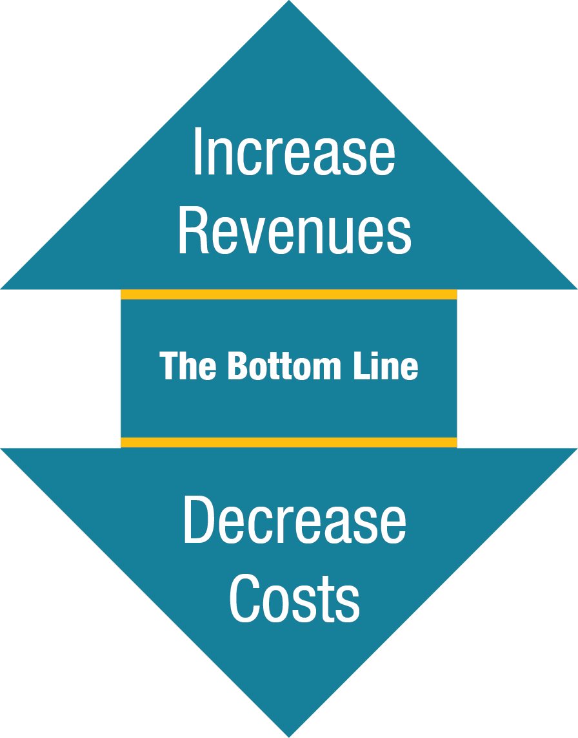
FDOT Sustainability Guidebook
The intent of the Guidebook is not to plan and define sustainability for Florida’s airports, but rather to provide a foundation and framework for airports to do so individually on their own.
Notes:
Why are you here today? What did FDOT develop? A sustainability guidebook that provides information that can be applied to all areas and levels at an airport. The overall goal of sustainability is to decrease costs and increase revenues for the airport through strategic planning and implementation.

Slide 3




What is Sustainability?
Making forward thinking decisions related to
  Administration
  Procurement
  Planning
  Design
  Construction
  Maintenance
  Operations
  EVERYWHERE ELSE!
Policies, procedures, and practices that
  Reduce facility and operational costs
  Better utilize existing resources
  Increase efficiency
  Put a greater emphasis on planning
Notes:
So what is sustainability? It is looking at all of the functions at the airport and how they can be made more operational and economically efficient, environmental and community friendly, and thought out thoroughly.
Sustainability can also be considered in the context of:
Environmental Stewardship
Risk Management
Strategic Planning
Economic Development
Business Continuity

Slide 4
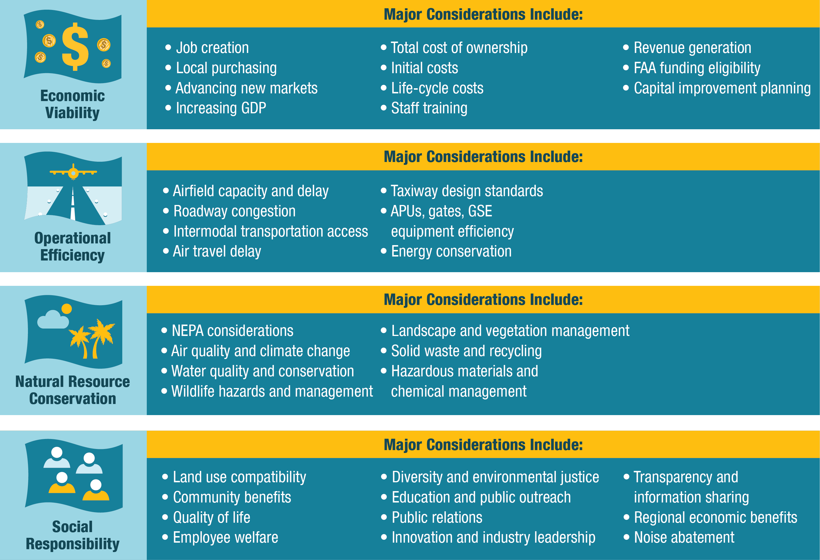
Focus Areas - EONS
Notes:
The airport industry has adopted the EONS approach which stands for Economic Viability, Operational Efficiency, Natural Resource Conservation, and Social Responsibility. This chart displays various components of airport operations that are included within each focus area.
Share some applicable examples to your specific airport – Under Social Responsibility is land use compatibility; it’s ensuring that the airport is a good neighbor by reviewing the uses of property within the flight paths. Under economic viability is maximizing revenue generating opportunities on property (including non-aeronautical). Under natural resources is landscape management; this may include using native plants or drip/low-flow irrigation. Under operational efficiency is customer service; this may include enhancing customer service through retail options, signage and convenience of passenger terminal design and operation.

Slide 5
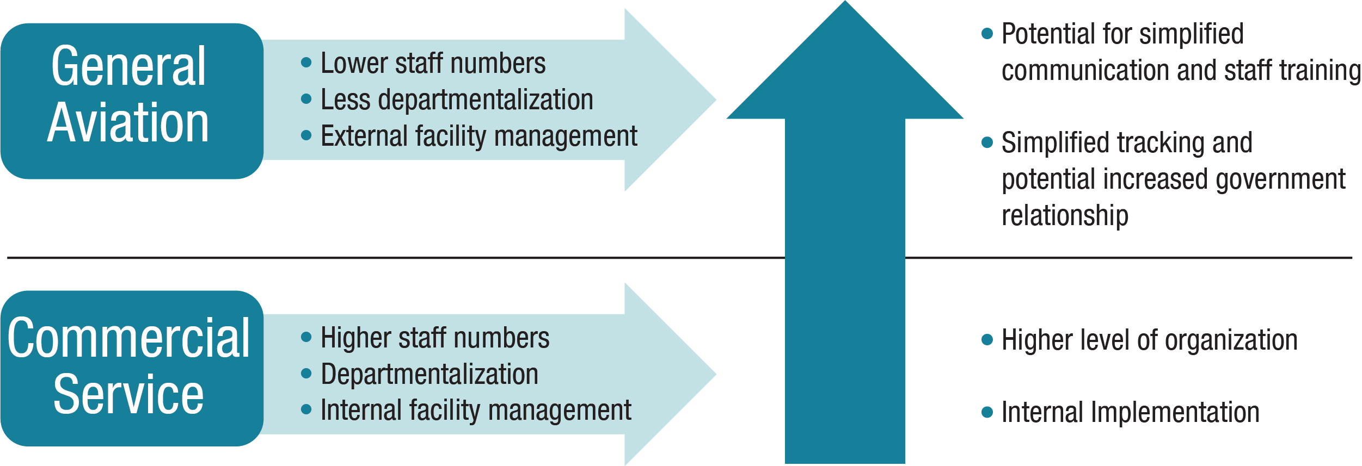
Commercial vs General Aviation
Obtainable at every airport within the available resources:
  Strategic Capital Improvement Planning (CIP)
  Coordination with Regional Planning Organizations
  Infrastructure (Pavement) Maintenance
  Promotion of Airport, Tenants, and Economic Benefit
  Preserving Capacity – Aircraft Operations and Storage
Notes:
Yes, there are typically more options and resources available to implement sustainability at commercial airports, but that doesn’t mean GA airports don’t see benefits as well. Here are a few examples that happen at every airport that can be reviewed for sustainability options.
Main difference for GA airports is opportunity to enhance the community understanding of airport benefits, which builds support for continued operation and future development

Slide 6
Importance of Sustainability
Improve financially self-sufficiency
Efficient use of resources (funding, environment, community, infrastructure, etc)
Enhance resiliency
Reduce environmental impacts
Increase community support
Placeholder: Insert individual airport/city mission, vision, or sustainability statement here!
Notes:
As aviation activity increases in Florida it is important that airports do what they can to maintain and improve the existing system and use the resources efficiently. An individual airport is always challenged to become financially self-sufficient. Becoming more efficient and strategic will assist in this goal. More efficiency means the airport has more flexibility during lean times (e.g., economic downturns) and strategic planning means the develop/operation of the airport has been thought out. Florida’s ecological system is diverse and revered by the world – it is important to preserve it.

Slide 7
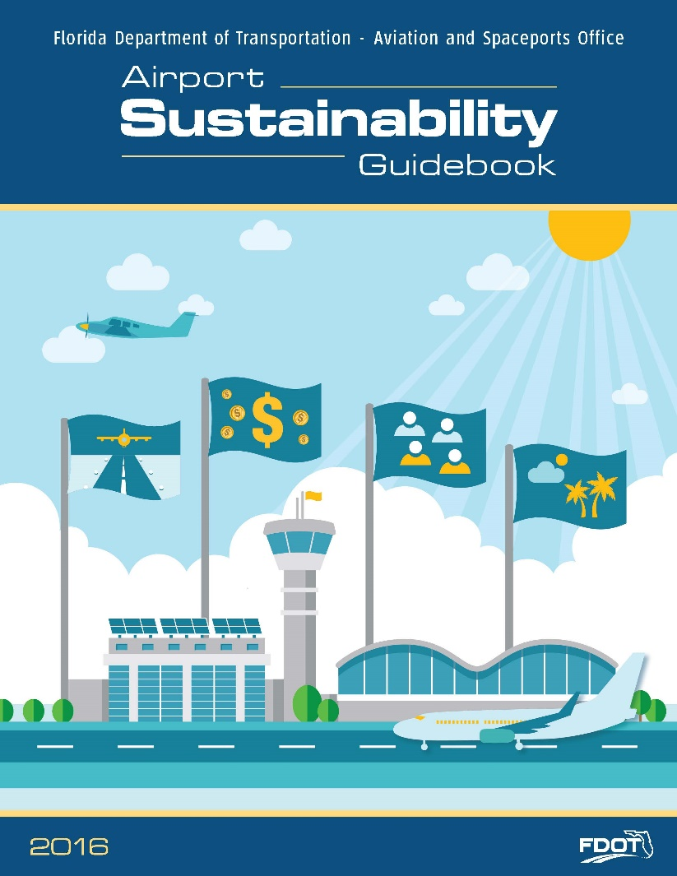
Purpose of the Guidebook
Reduces operating costs at airports
Results in better utilization of airport assets
Better addresses fluctuating energy costs
Stretches AIP and FDOT funding further
Reduces environmental impacts
Builds community support for and positively impacts the public perception of airports
Notes:
Why did FDOT create the guidebook? It increases the resources available to airport sponsors to be successful.
How does the guidebook help the airport sponsor with sustainability? Helps with strategic planning, provides templates and tools, provides a starting point, gives basic ideas.

Slide 8
How Was the Guidebook Developed?
Nine regional CFASPP meetings
Technical Advisory Committee meetings
Online survey of public-use airports
Comprehensive literature review
Agency stakeholder interviews
Real world application
  Eight airport stakeholder interviews
  Six airport case studies
Notes:
The guidebook using real world examples, methods, stakeholders, and planning to provide a more comprehensive and implementable sustainability effort.
Guidebook stakeholders included:
Naples Municipal Airport
Venice Municipal Airport
St. Pete.-Clearwater International Airport
Greater Orlando Aviation Authority
Miami-Dade Aviation Authority
Tallahassee International Airport
Lee County Port Authority
Sarasota International Airport
Ft. Lauderdale-Hollywood International
Tampa International Airport
Vero Beach Regional Airport
Jacksonville Aviation Authority
Atlanta International Airport
Federal Aviation Administration
Florida Department of Environmental Protection
Department of Economic Opportunity
Florida Department of Agriculture and Consumer Services
National Oceanic and Atmospheric Administration

Slide 9
Relationship of Sustainability to Other Planning Efforts
Sustainability Planning
Master Plans
NEPA Process
Grant Mgmt.
Strategic Plans
Airport Layout Plans
CIP
Business Plans
Notes:
Sustainability can be tied into existing efforts at every level and in every functional area of an airport. The guidebook provides tools and examples specifically to stand-alone sustainability plans, within master plans, and as ad-hoc planning. This diagram demonstrates that sustainability can be considered in those larger plans and also annually during the Capital Improvement Plans (CIP), managing grant funds, during the environmental approval process, and more.

Slide 10
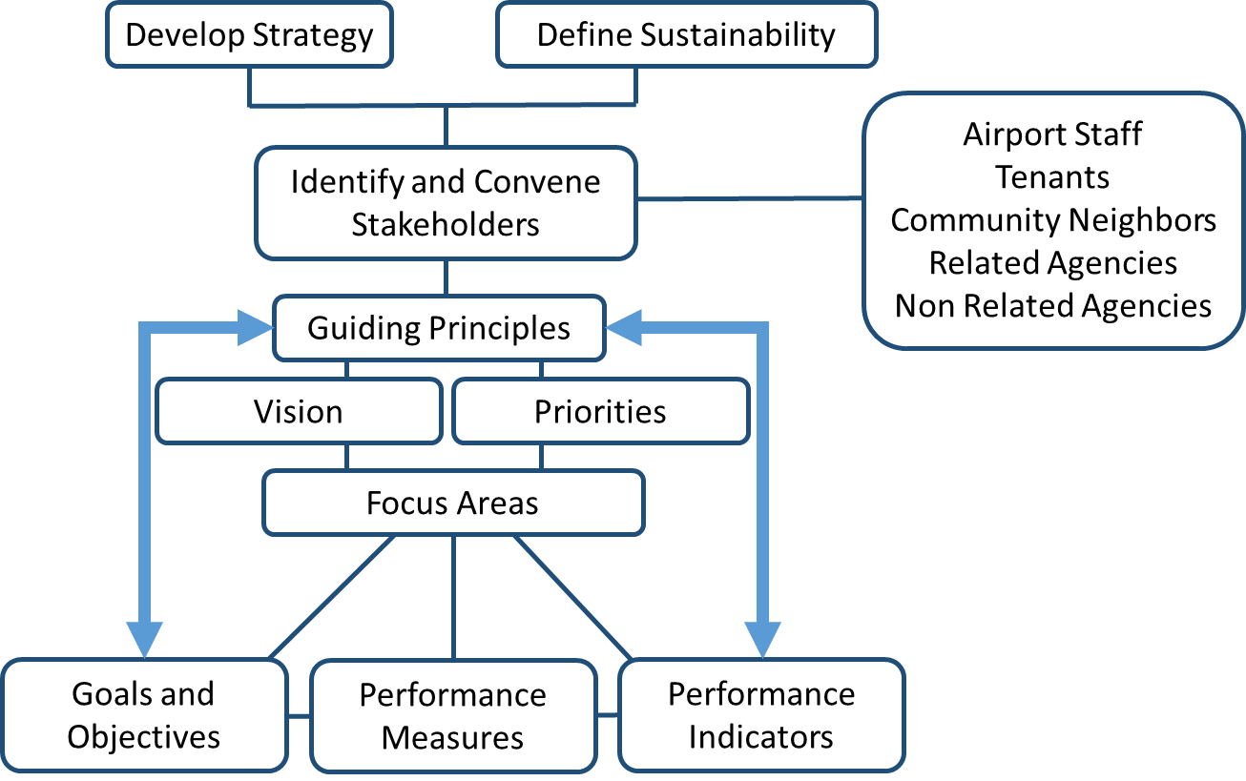
Phase I – Setting the Stage
Flow and Structure
Notes:
This is the initial process of applying sustainability at an airport. Airport staff should first define what sustainability means to that specific airport and decide how they want to go about it (master plan, stand-alone document, ad hoc initiatives, etc). Once the overall idea of sustainability is determined, stakeholders should be involved (example of stakeholders provided). This team is important to obtain an early buy-in from airport stakeholders and is integral to the overall success and longevity of the plan.
The team can come up with a vision statement and priorities for the airport that can be related to specific focus areas (EONS). Using the guidebook and its resources, the team can set goals and objectives for each focus area topic and determine how it will be measured.

Slide 11
Examples
Sustainability Definition:
An airport pursues sustainability by providing an efficient air transportation system for citizens while working with local and regional stakeholders to promote accessibility for all, to support economic development, and to protect the environment for current and future generations.
Mission:
“To provide safe and efficient aviation facilities and associated services to both commercial and non-commercial users, while operating in harmony with the community’s quality of life goals.”
- Vero Beach Regional Airport Sustainable Master Plan (2016)

Slide 12
Phase I – Setting the Stage
Application in Guidebook
SMART
Objectives
Specific
Measurable
Attainable
Relevant
Time Bound
Objective Ordering Questions
What is hoped to be done? (long-term, hope-based objective)
What should be done? (Intermediate-term, benefit-based objective)
What must be done? (Short-term, necessity-based objective)
Notes:
Here is an example of some of the guiding principals/questions when selecting focus areas and objectives.

Slide 13
Examples:
Goal | Objectives
Reduce the total energy use and demand of the airport and increase renewable energy generation on airport property. | Complete energy efficiency projects to reduce energy use in airport facilities Increase renewable energy generation on airport property Leverage people (energy users) to promote energy efficiency
Reduce waste generation and increase diversion from landfills | Engage employees, passengers, and tenants in waste reduction and recycling efforts Develop capacity for composting or recovering energy from food scraps and other compostables Increase the landfill diversion

Slide 14
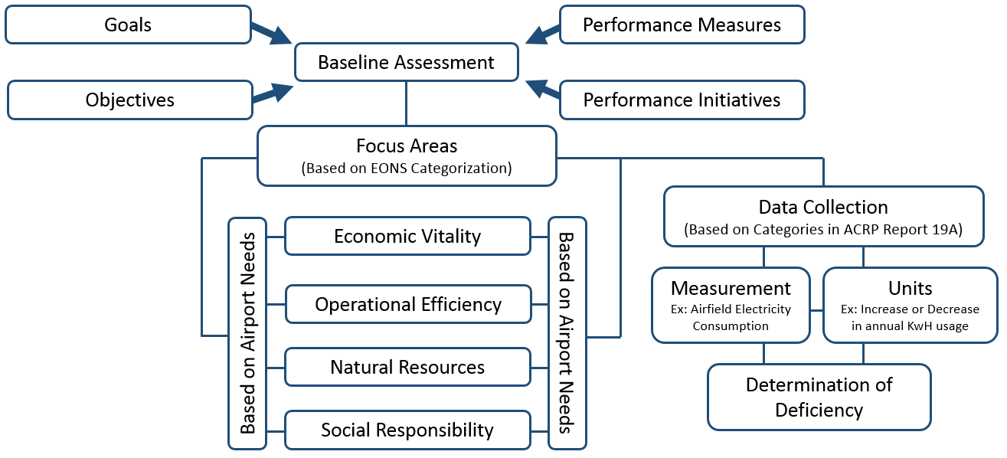
Phase II – Baseline Assessment
Flow and Structure
Performance Indicators
Notes:
Phase II is conducting a baseline assessment. This provides a starting point upon which to measure progress towards achieving the goal.

Slide 15
Phase II – Baseline Assessment
Application in Guidebook
Resource Category | Goals | Objectives | Metrics | Current Level | Target | Initiatives | Action Steps
Energy (Natural Resources) | Reduce the total energy use and demand of the airport and increase renewable energy generation on airport property | Complete energy efficiency projects to reduce energy use in airport facilities | Total Electricity use per Passenger (MMBTu/passenger) | 0.16/Passenger | Reduce overall energy consumption by 25% by 2020 | Select a power-down or “sleep mode” feature on the computer central processing unit and monitor | Who: Office Staff When: Immediately Resources Needed: None
Notes:
Here is an example of what we could expect to come out of the first two steps. The focus area is energy (under Natural Resources). There is a goal to ___ with an objective to ___. We’re measuring it using _____. It is currently at 0.16 MMBTu per passenger and targeted to be reduced by 25% by 2020.
Phase III covers the initiatives and action steps. In this case, to reduce energy use by 25%, the airport is putting sleep modes on the computers. It will be implemented by the office staff immediately. This is an example of an initiative that does not need any additional resources.

Slide 16
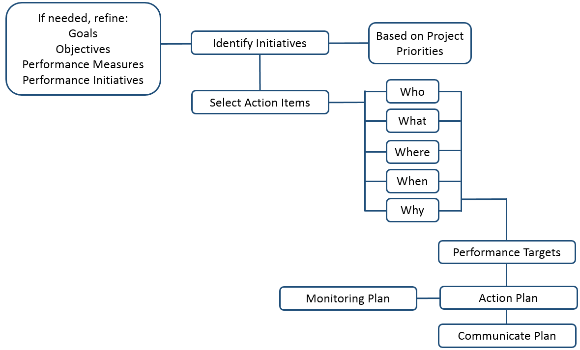
Phase III – Development
Flow and Structure
Notes:
Phase III determines how the goals will be met by identifying initiatives and how they will be implemented. The standard questions of who, what, where, when, and why need to be answered to ensure the plan will successfully be implemented.

Slide 17
Example Initiatives
Goal | Objective | Initiative
Reduce the total energy use and demand of the airport and increase renewable energy generation on airport property | Complete energy efficiency projects/strategies to reduce energy use in airport facilities | Operate passenger terminal Air Handling Unit at 50% speed between 9 pm and 6 am.
Leverage people (energy users) to promote energy efficiency | Increase customer education of energy waste to promote energy conscious mindset | Conduct recurrent tenant training on Airport energy reduction goals and strategies

Slide 18
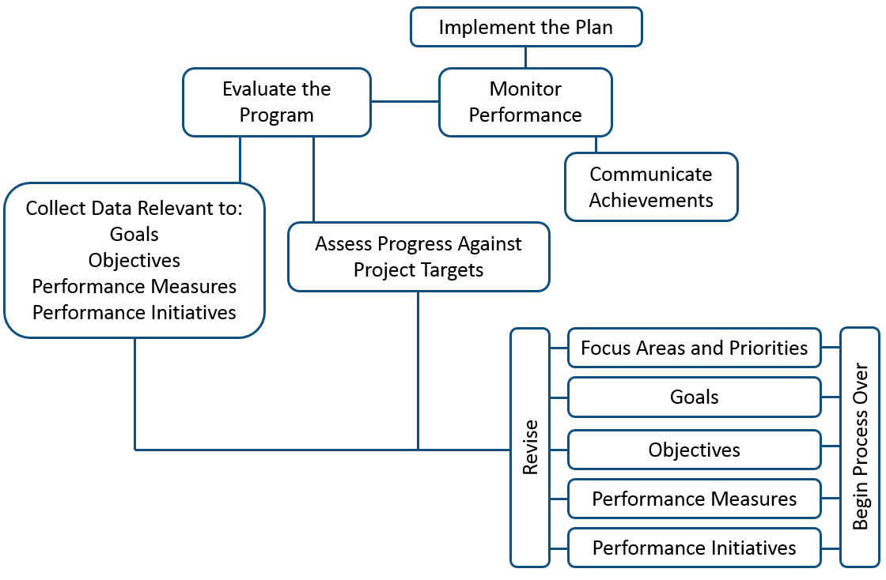
Phase IV – Implementation
Flow and Structure
Notes:
Phase IV is the actual implementation and monitoring of the plan. The plan should be periodically evaluated to ensure the priorities and goals are still relevant and inline with the airport’s vision and that the initiatives are implementable. It is anticipated that adjustments will need to be made.

Slide 19
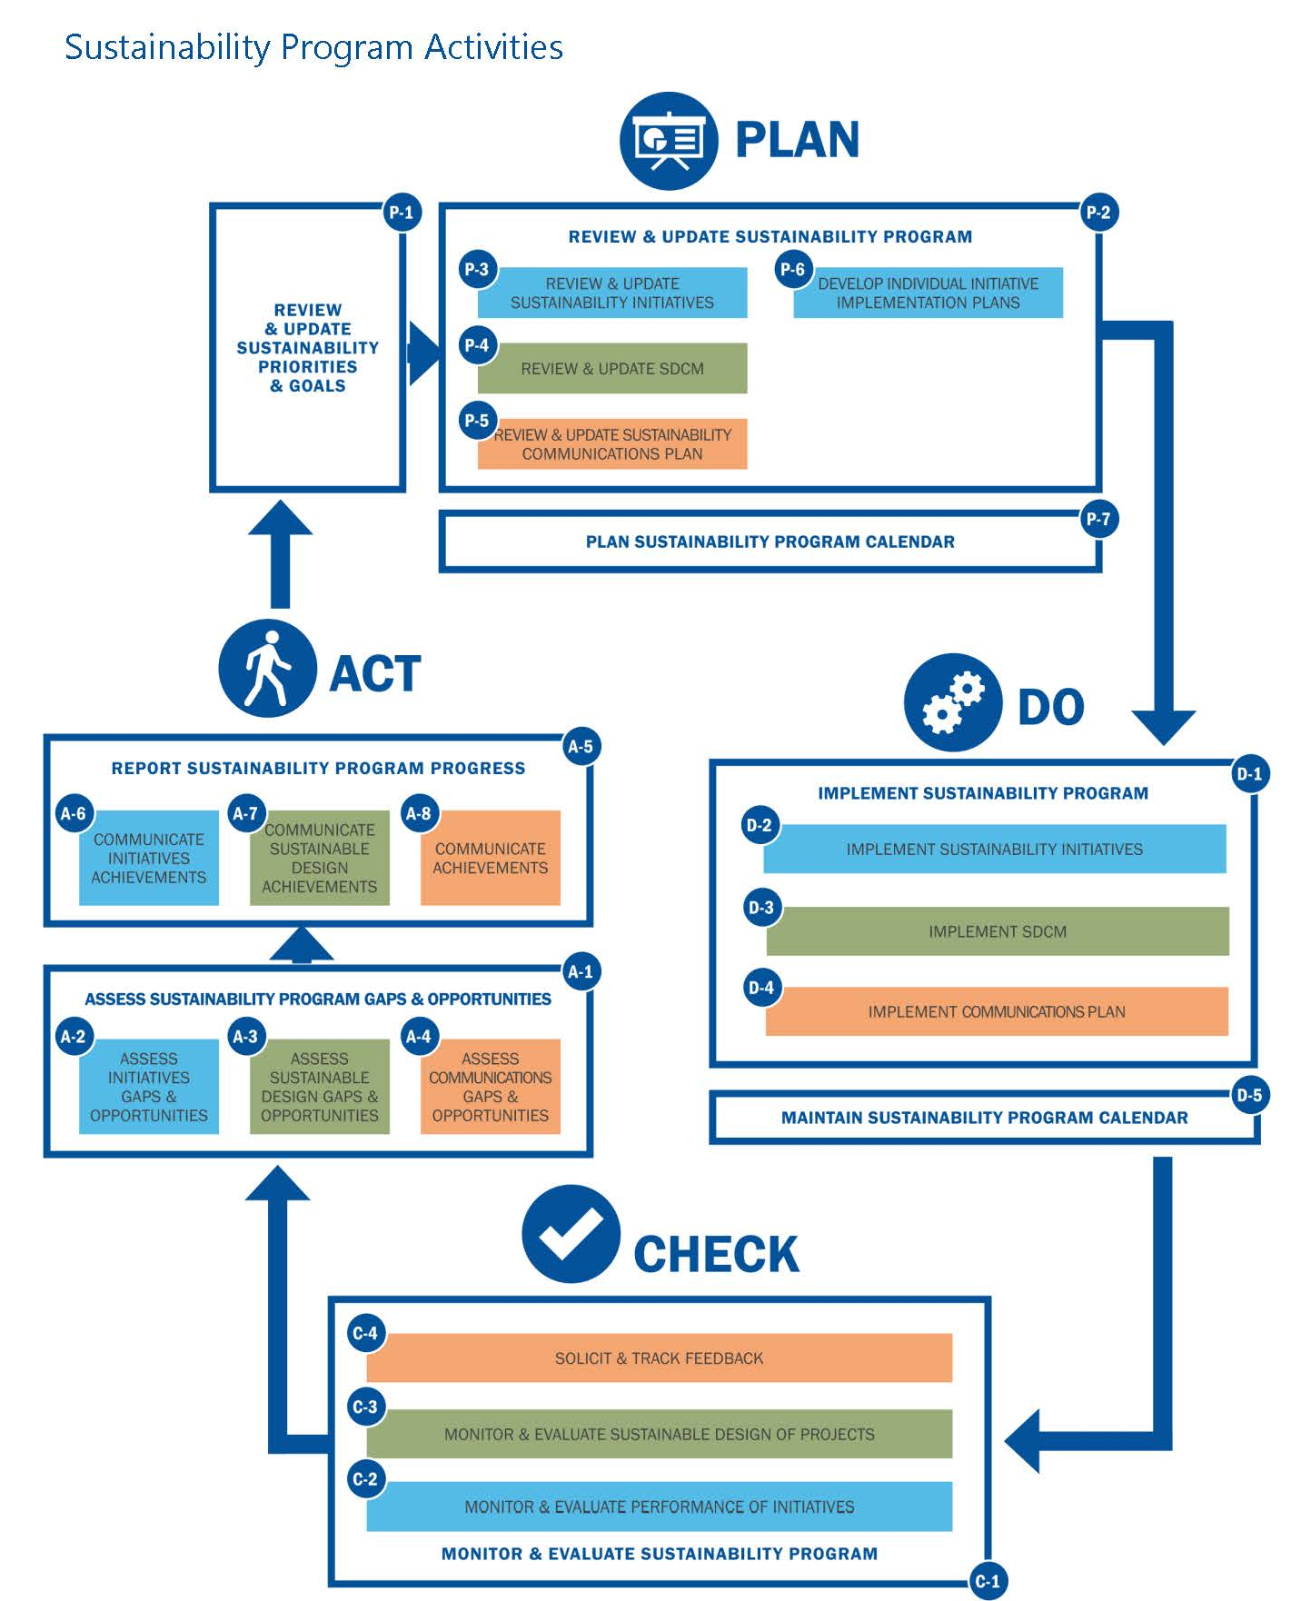
Phase IV – Implementation
Application in Guidebook
Notes:
Implementation and Monitoring of the plan is a constant series of planning for sustainability, physically doing the action items, checking on the progress, and acting on changes as necessary.

Slide 20
FDOT’s Next Steps
Airport recognition program
  Recognizes airports for their efforts related to sustainability
  All-inclusive voluntary program to recognize cost-saving practices at airports
  Developed to be applied to additional modes of transportation
Interactive tools
  Suite of tools designed to “automate” sustainability planning
  Hosted on the FAD or CFASPP website
Notes:
What does FDOT plan to do for airports following sustainability? An airport recognition program that includes recognizing and rewarding airports that implement cost savings. Develop a set of interactive tools to assist airport sponsors with sustainability.

Slide 21
Questions?

Slide 22
Airport Toolbox
Interactive sustainability resource materials
  Interactive PDF that provides links to sustainability resources
Informational brochures
  Airports/consultants
  Airport partners and stakeholders
Training presentation template
  PowerPoint presentation that can be used to educate airports, local governments, and others on sustainability planning
Notes:
Here are tools that are provided as part of the Guidebook.

Slide 23
Appendices
Available Resources
  SAGA website and database
  Relevant ACRP publications and tools
  Airport industry group committees (FAC, ACI)
  Global Reporting Initiative
  Sustainability rating systems
  Summary of student research findings
Available tools
  Baseline assessors
  Initiative selectors
  Tracking and monitoring
  Report templates

