Slide 1


Slide 2
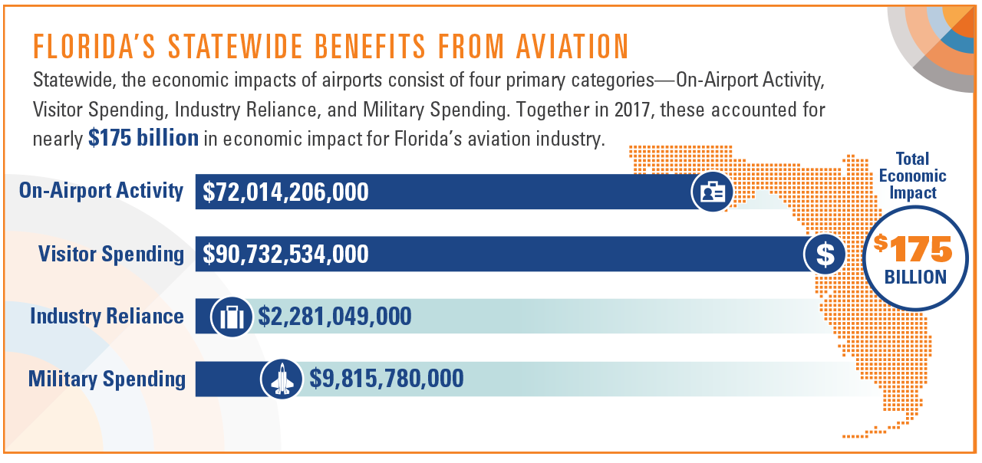

Slide 3
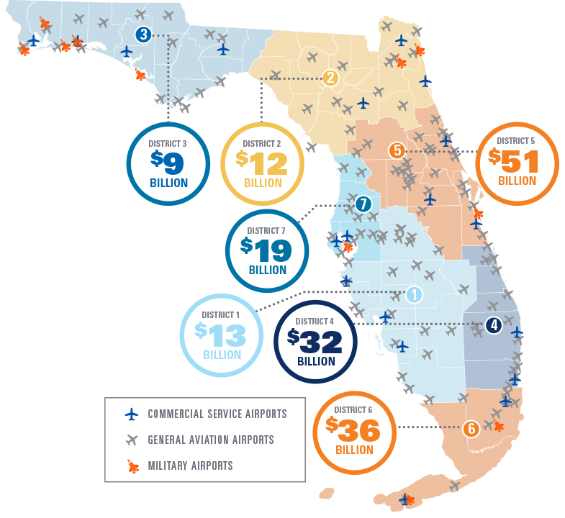
STATEWIDE IMPACTS
Large hub airports resulted in a significant impact
  District 5: Orlando International Airport (MCO)
  District 6: Miami International Airport (MIA)
  District 4: Fort Lauderdale International Airport (FLL)
  District 7: Tampa International Airport (TPA)
Visitor spending comprised the greatest proportion of impacts in District 1 and District 7
Military activity generated the majority of impacts in District 3

Slide 4
FDOT District Impacts
FDOT District | On-Airport Activity | Visitor Spending | Industry Reliance | Military Spending | Total
1 | $3,464,014,000 | $9,735,602,000 | N/A | N/A | $13,199,616,000
2 | $7,044,109,000 | $2,444,984,000 | N/A | $2,469,447,000 | $11,958,540,000
3 | $2,073,727,000 | $2,450,817,000 | N/A | $4,893,403,000 | $9,417,946,000
4 | $13,189,292,000 | $18,859,906,000 | N/A | N/A | $32,049,197,000
5 | $20,528,246,000 | $29,224,709,000 | N/A | $850,499,000 | $50,603,454,000
6 | $19,901,216,000 | $15,455,223,000 | N/A | $583,953,000 | $35,940,392,000
7 | $5,813,602,000 | $12,561,293,000 | N/A | $1,018,478,000 | $19,393,374,000
Statewide | $72,014,206,000 | $90,732,534,000 | $2,281,049,000 | $9,815,780,000 | $174,843,568,000

Slide 5
FDOT District Impacts

Slide 6
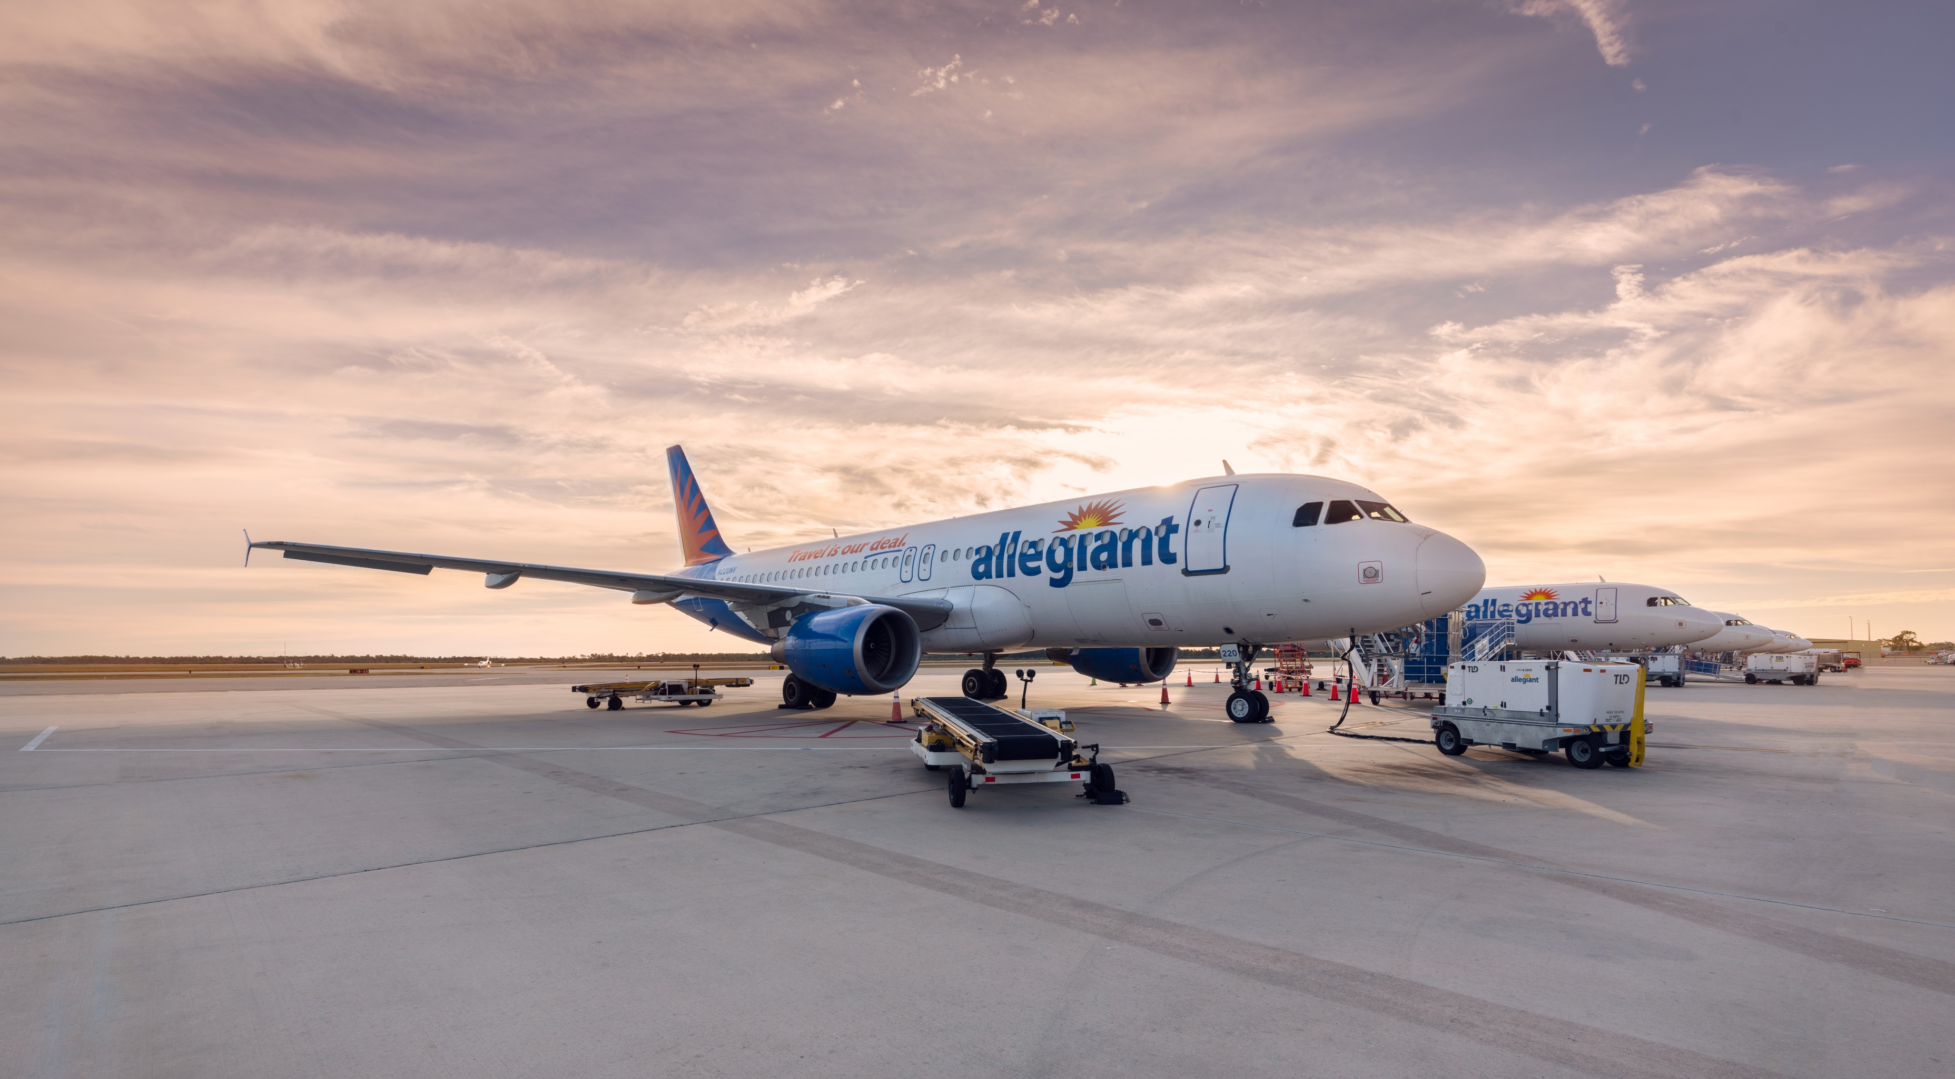
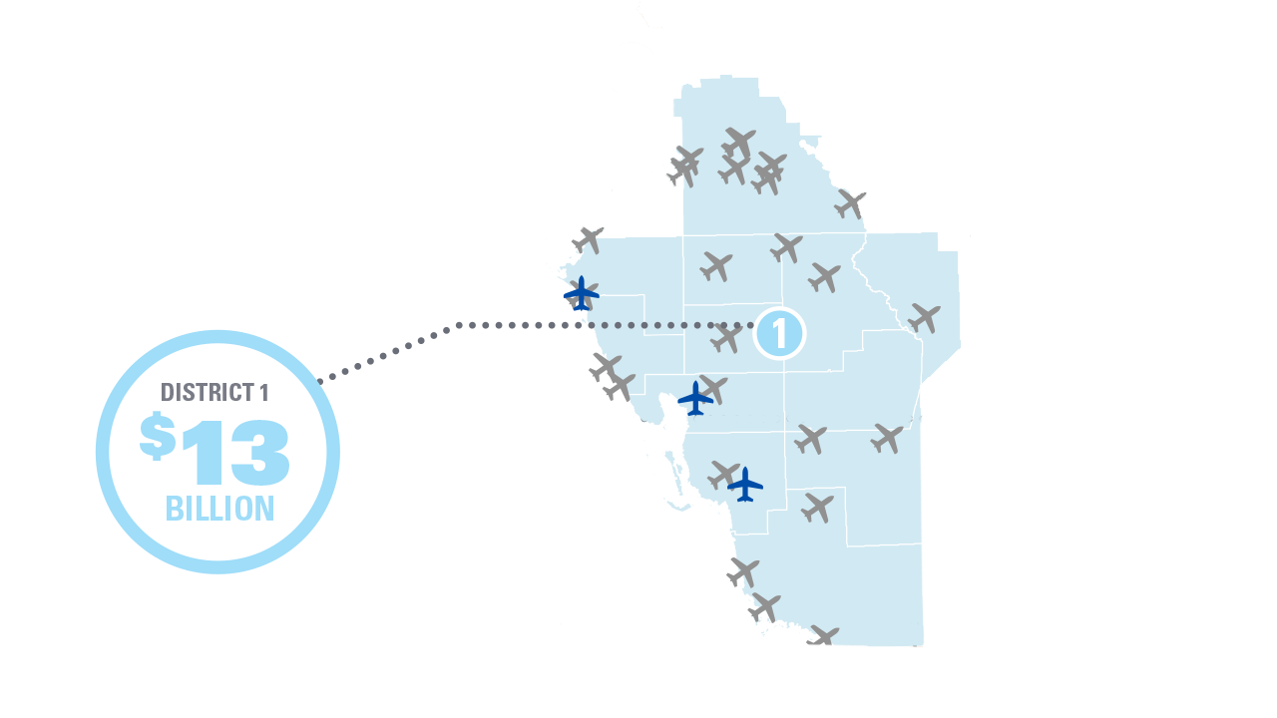
FDOT DISTRICT 1
On-Airport Activity: $3.5 billion
Visitor Spending: $9.7 billion
NPIAS Role | Number of Airports
Medium Hub | 1
Small Hub | 2
Non-Hub | 1
National | 3
Regional | 5
Local | 8
Basic | 3
Unclassified | 1
*Totals may not add due to rounding.

Slide 7
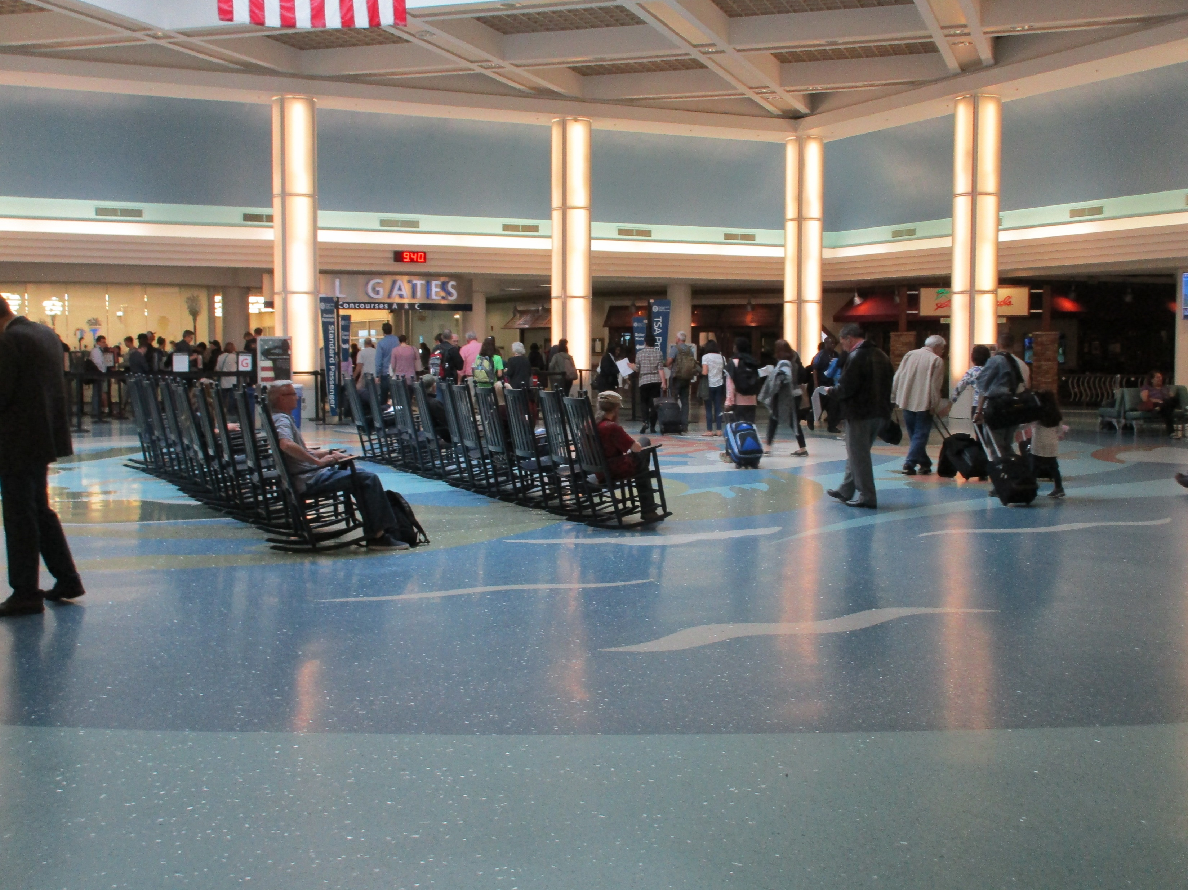
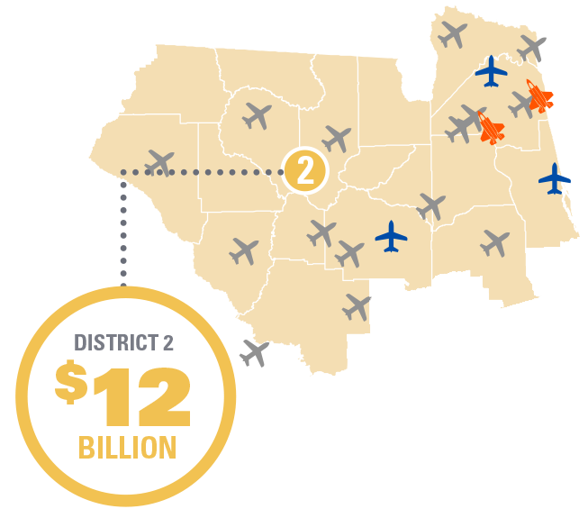
FDOT DISTRICT 2
On-Airport Activity: $7 billion
Visitor Spending: $2.4 billion
Military Spending: $2.5 billion
NPIAS Role | Number of Airports
Medium Hub | 1
Non-Hub | 2
Regional | 4
Local | 6
Basic | 3
*Totals may not add due to rounding.

Slide 8
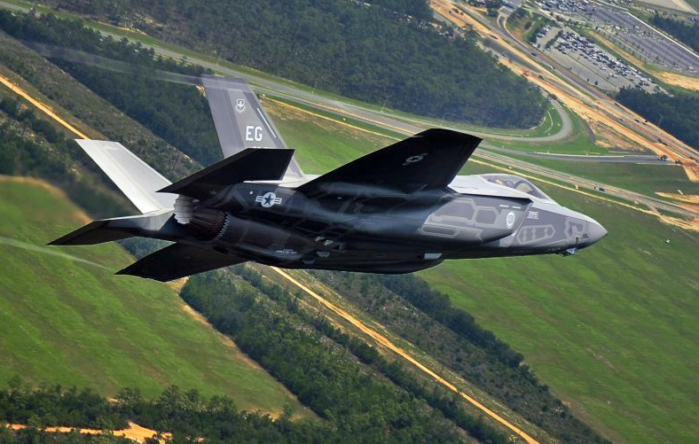
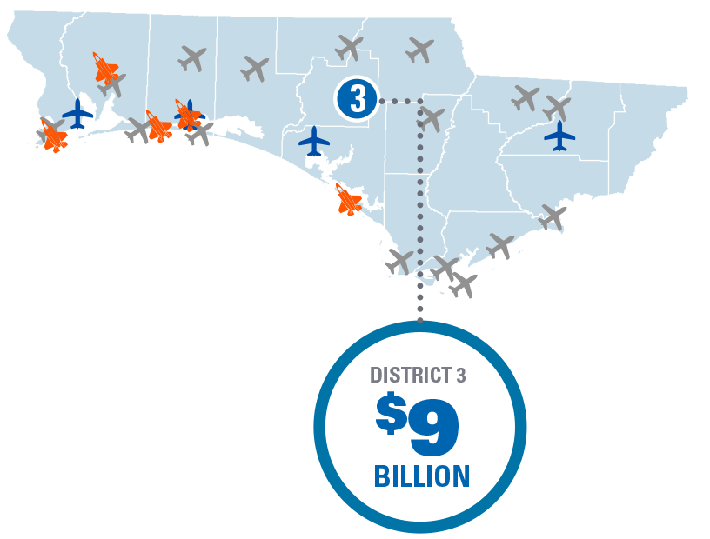
FDOT DISTRICT 3
On-Airport Activity: $2 billion
Visitor Spending: $2.5 billion
Military Spending: $4.9 billion
NPIAS Role | Number of Airports
Small Hub | 3
Non-Hub | 1
Regional | 2
Local | 6
Basic | 1
*Totals may not add due to rounding.

Slide 9

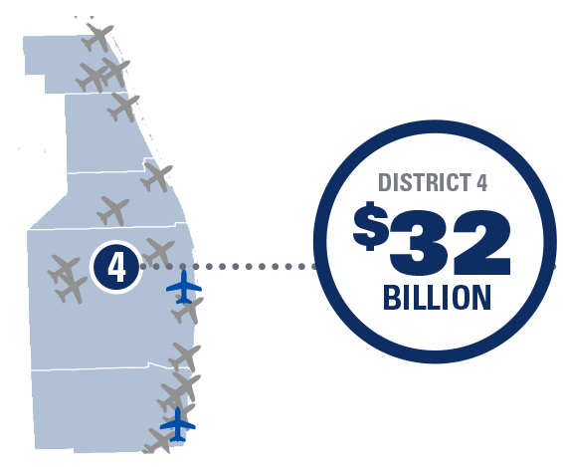
FDOT DISTRICT 4
On-Airport Activity: $13.2 billion
Visitor Spending: $18.9 billion
NPIAS Role | Number of Airports
Large Hub | 1
Medium Hub | 1
National | 4
Regional | 5
Local | 2
Basic | 1
*Totals may not add due to rounding.

Slide 10
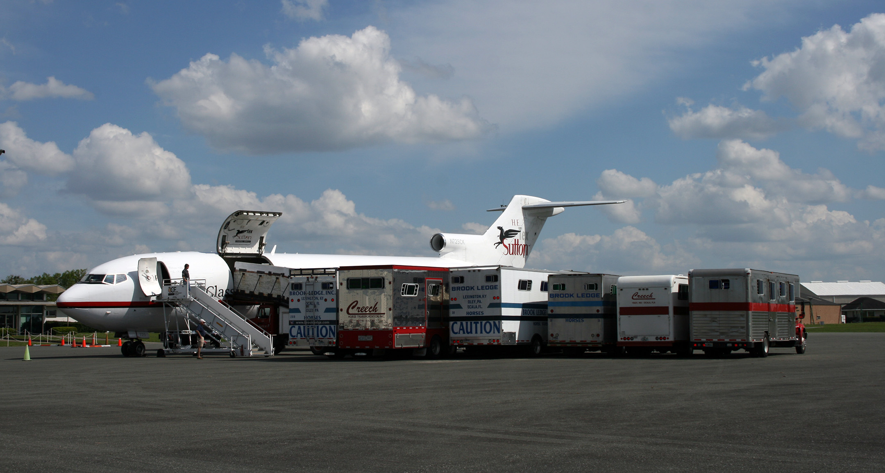
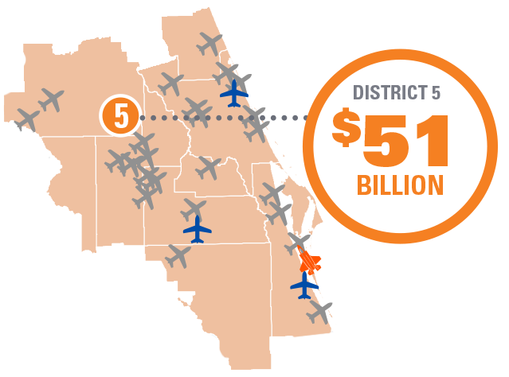
FDOT DISTRICT 5
On-Airport Activity: $20.5 billion
Visitor Spending: $29.2 billion
Military Spending: $851 million
NPIAS Role | Number of Airports
Large Hub | 1
Small Hub | 1
Non-Hub | 2
National | 1
Regional | 8
Local | 4
Basic | 1
*Totals may not add due to rounding.
Does not include Cape Canaveral Spaceport.

Slide 11
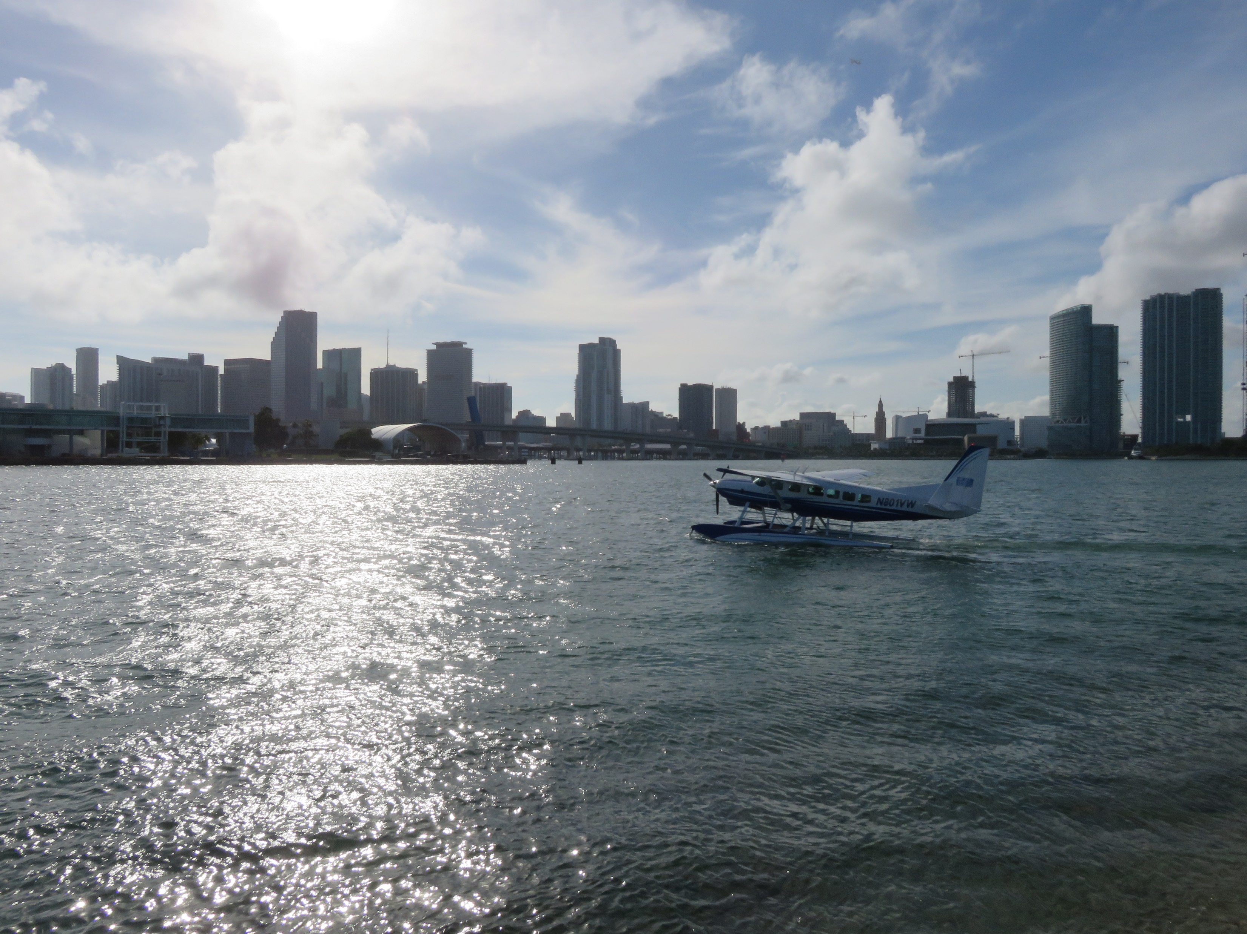
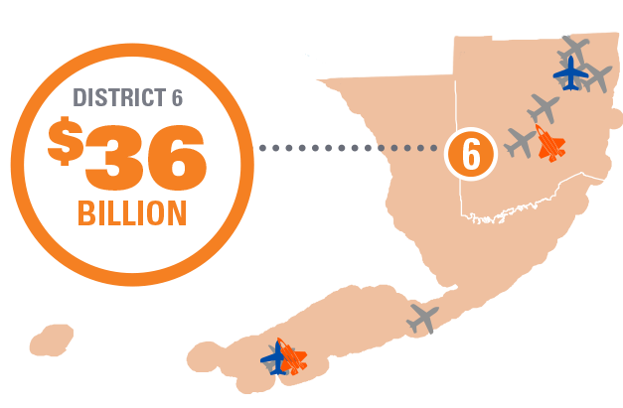
FDOT DISTRICT 6
On-Airport Activity: $20 billion
Visitor Spending: $15.5 billion
Military Spending: $584 million
NPIAS Role | Number of Airports
Large Hub | 1
Non-Hub | 1
National | 1
Regional | 2
Local | 2
Basic | 1
*Totals may not add due to rounding.

Slide 12
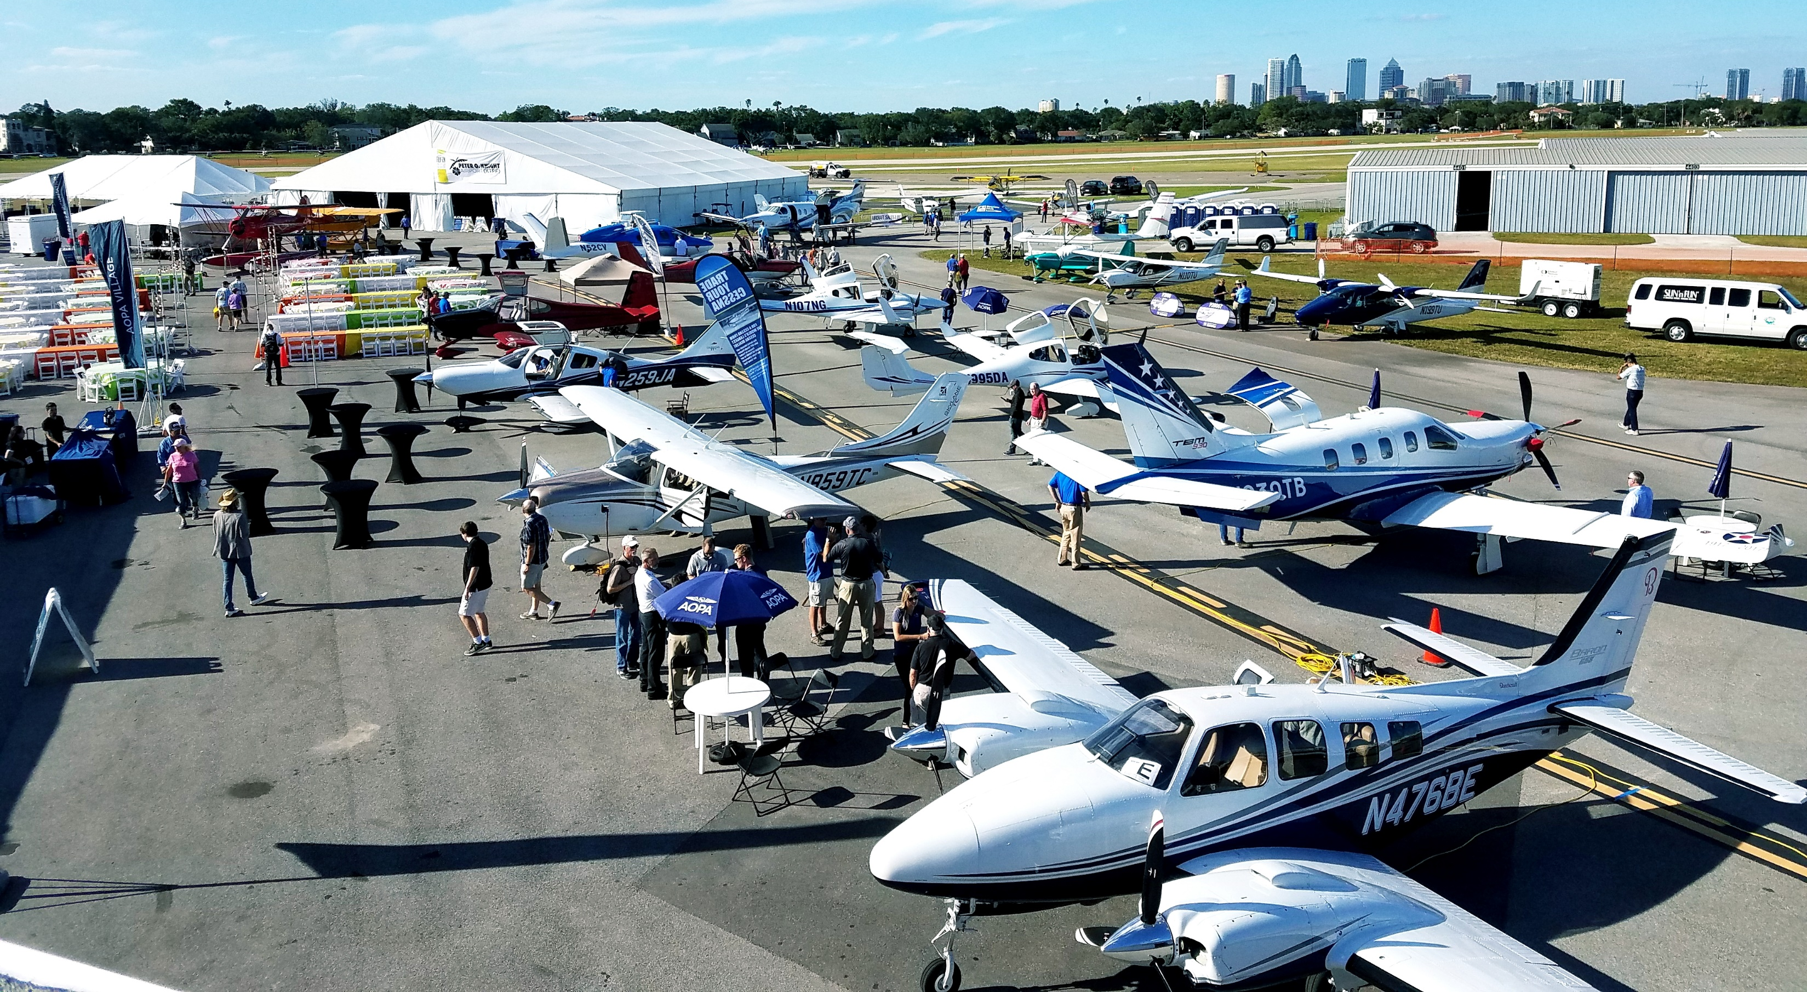
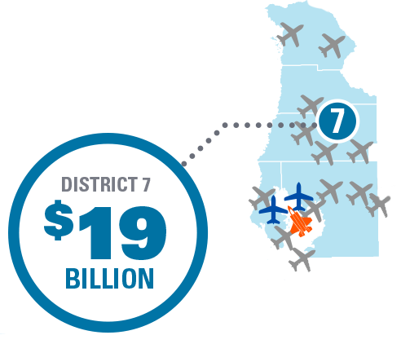
FDOT DISTRICT 7
On-Airport Activity: $5.8 billion
Visitor Spending: $12.6 billion
Military Spending: $1 billion
NPIAS Role | Number of Airports
Large Hub | 1
Small Hub | 1
Regional | 4
Local | 5
*Totals may not add due to rounding.

Slide 13
Florida NPIAS Breakdown
NPIAS Role | District 1 | District 2 | District 3 | District 4 | District 5 | District 6 | District 7 | Total
Large Hub |  |  |  | 1 | 1 | 1 | 1 | 4
Medium Hub | 1 | 1 |  | 1 |  |  |  | 3
Small Hub | 2 |  | 3 |  | 1 |  | 1 | 7
Non-Hub | 1 | 2 | 1 |  | 2 | 1 |  | 7
National | 3 |  |  | 4 | 1 | 1 |  | 9
Regional | 5 | 4 | 2 | 5 | 8 | 2 | 4 | 30
Local | 8 | 6 | 6 | 5 | 4 | 2 | 5 | 36
Basic | 3 | 3 | 1 | 1 | 1 | 1 |  | 10
Unclassified | 1 |  |  |  |  |  |  | 1
Total | 24 | 16 | 13 | 17 | 18 | 8 | 11 | 107

Slide 14
Airport Impacts

Slide 15
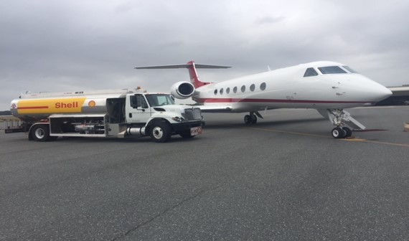
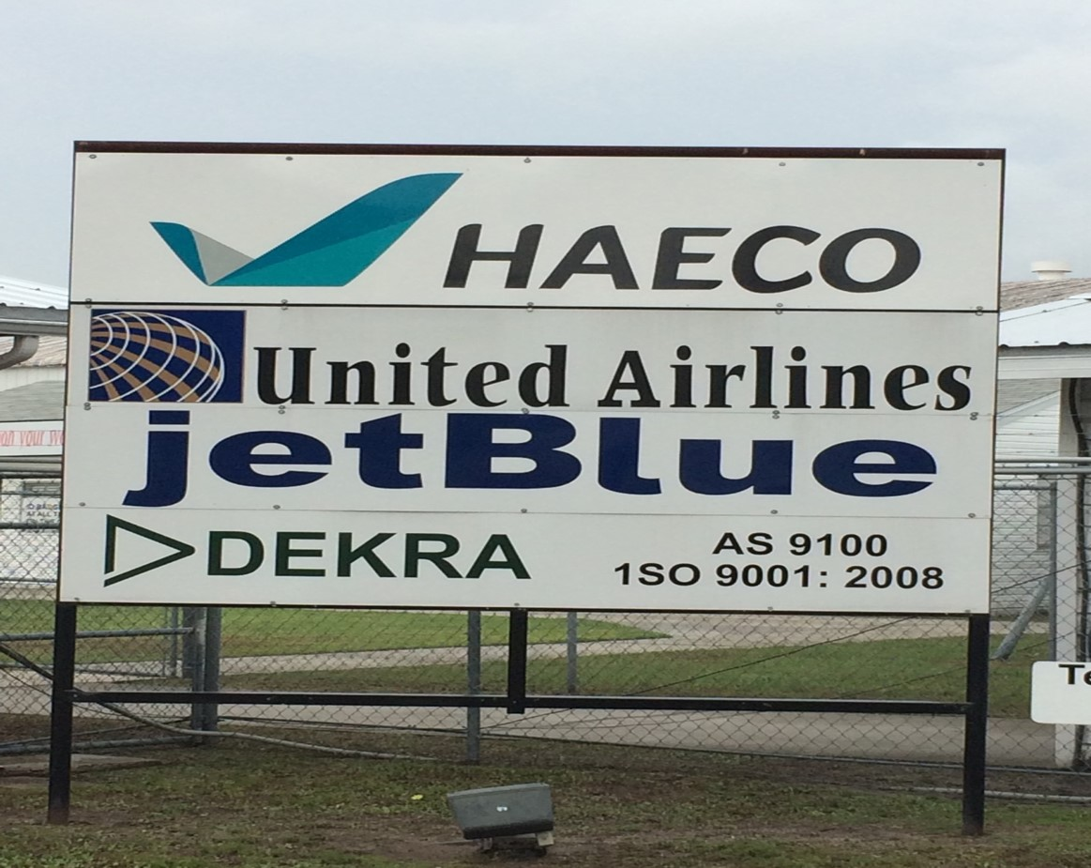
Lake City Gateway Airport
On-Airport
Impacts
$592,436,000
Multiplier
Effects
$402,687,000
Total Employment
4,079
Total Payroll
$243,024,000
Total Output
$1,004,033,000
Visitor Spending
Impacts
$8,911,000

Slide 16
Airport Impacts
On Airport
Impacts
$X,XXX,XXX
Multiplier
Effects
$X,XXX,XXX
Total Employment
XXX
Total Payroll
$X,XXX,XXX
Total Output
$XX,XXX,XXX
Visitor Spending
Impacts
$X,XXX,XXX

Slide 17
Study, Research, &
Results

Slide 18
STUDY APPROACH
Data Collection by FDOT Aviation and Spaceports Office from:
  Airport administration
  On-airport businesses
  Commercial service and general aviation out-of-state visitors
  Aviation reliant businesses
Measured Economic Impacts using IMPLAN, an economic modeling software
Reported jobs, payroll, and output
PURPOSE
To understand the overall role of aviation in supporting Florida’s economy

Slide 19
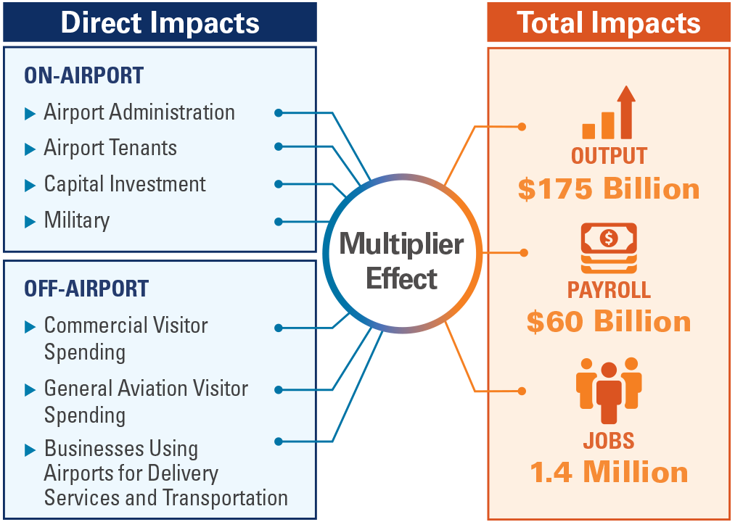
MEASURING IMPACTS
Direct impacts: are related to the provision of aviation services, out-of-state visitors’ spending, or the activity of aviation-reliant businesses
Multiplier Effect
  Supplier purchases (indirect impacts): occur when directly affected businesses use a portion of direct business revenue to purchase goods and services from other Florida businesses
  Employee spending (induced impacts): occur when workers who earn income due to direct sales and supplier sales spend their wages in Florida to purchase household goods and services, such as groceries, rent, entertainment and other goods and services

Slide 20
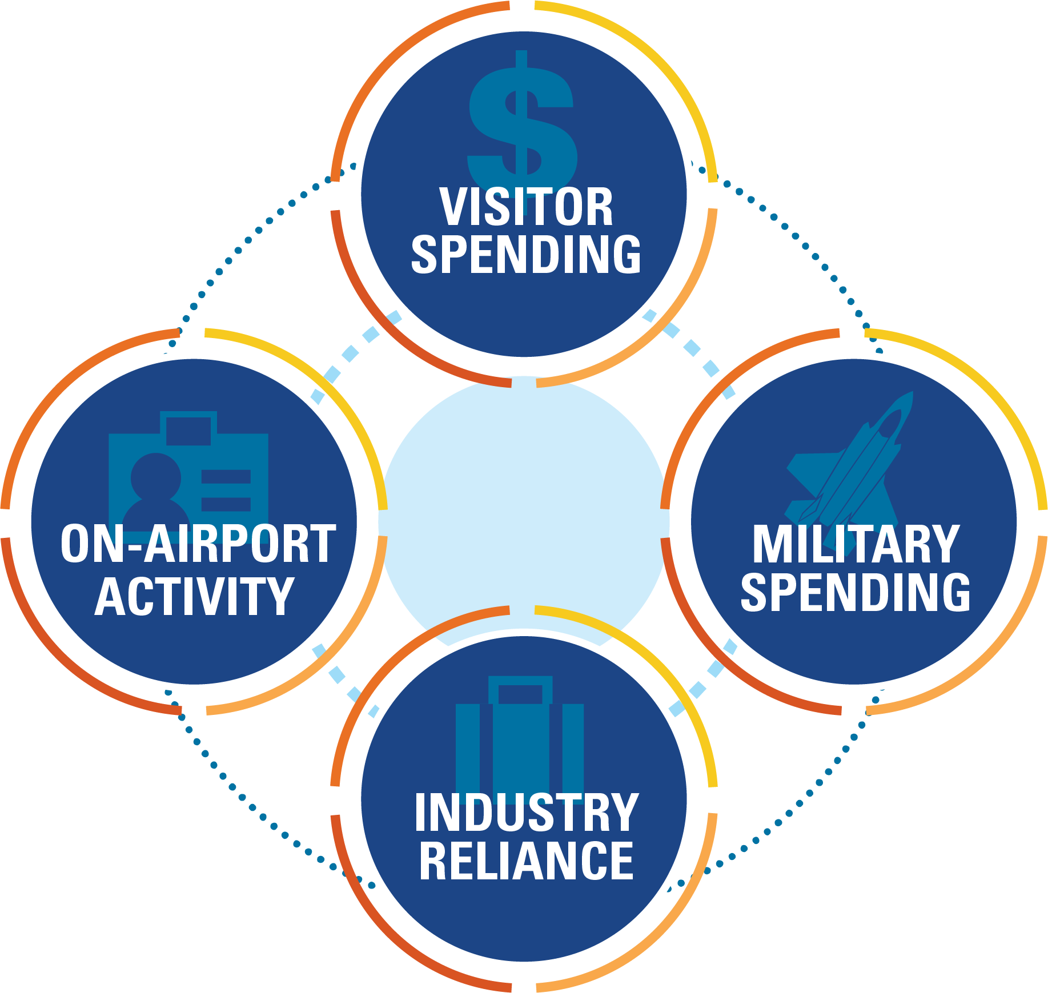
COMMUNICATING RESULTS
On-Airport Activity: impacts related to the activity of airport administration, business tenants, and capital improvements on airports
Visitor Spending: impacts related to out-of-state visitors’ spending, i.e. the money they spend on goods and services at hospitality businesses
Military Spending: impacts related to military capital expenditures and payroll
Industry Reliance: the portion of aviation reliant activity that is generated by businesses that rely on airports for delivery services and transportation

Slide 21
Thank you!

